Slide 1
PSYCHOLOGY (8th Edition) David Myers
PowerPoint Slides
Aneeq Ahmad
Henderson State University
Worth Publishers, © 2006

Slide 2
Focuses in Social Psychology
“We cannot live for ourselves alone.”
Herman Melville
Social psychology scientifically studies how we think about, influence, and relate to one another.
Notes:
OBJECTIVE 1| Describe the three main focuses of social psychology.

Slide 3
Principles of Socio-Cultural Psych
Humans are social animals w/ need to belong
- Group individual influence is bidirectional
Culture influences behavior
We have individual identity and social self
People’s views of the world are resistant to change
Pg. 101-102 Companion Book

Slide 4
Social Thinking
Does his absenteeism signify illness, laziness, or a stressful work atmosphere?
Was the horror of 9/11 the work of crazed evil people or ordinary people corrupted by life events?
Social thinking involves thinking about others, especially when they engage in doing things that are unexpected.

Slide 5
Watch this video and explain the behavior

Slide 6
Attributing Behavior to Persons or to Situations
Attribution Theory: Fritz Heider (1958) suggested that we have a tendency to give causal explanations for someone’s behavior, often by crediting either the situational factors (external) or the dispositional factors (personal).
http://www.stedwards.edu
Fritz Heider
Notes:
OBJECTIVE 2| Contrast dispositional and situational attributions, and explain how the fundamental attribution error can affect our analysis of behavior.

Slide 7
Attributing Behavior to Persons or to Situations
A teacher may wonder whether a child’s hostility reflects an aggressive personality (dispositional attribution) or is a reaction to stress or abuse (a situational attribution).
Dispositions are enduring personality traits. So, if Joe is a quiet, shy, and introverted child, he is likely to be like that in a number of situations.
Actor-Observer Effect
http://www.bootsnall.org

Slide 8
Fundamental Attribution Error
The tendency to overestimate the impact of personal disposition and underestimate the impact of the situations in analyzing the behaviors of others leads to the fundamental attribution error.
We see Joe as quiet, shy, and introverted most of the time, but with friends he is very talkative, loud, and extroverted.
Lee study on pg. 105 Companion Guide

Slide 9
Self-Serving Bias
Take credit for your successes and credit dispositional factors vs. dissociation from failures and blame situational factors
Defensive self-esteem is fragile and egotistic whereas secure self-esteem is less fragile and less dependent on external evaluation.

Slide 10
Attitude
A belief and feeling that predisposes a person to respond in a particular way to objects, other people, and events.
If we believe a person is mean, we may feel dislike for the person and act in an unfriendly manner.
Notes:
OBJECTIVE 3| Define attitude.

Slide 11
Attitudes Can Affect Action
Our attitudes predict our behaviors imperfectly because other factors, including the external situation, also influence behavior.
Democratic leaders supported Bush’s attack on Iraq under public pressure. However, they had their private reservations.
Or did they?
Could it be that they actually changed based on what they stood for publicly?
Notes:
OBJECTIVE 4| Describe the conditions under which attitudes can affect actions.

Slide 12
Attitudes Can Affect Action
Not only do people stand for what they believe in (attitude), they start believing in what they stand for.
D. MacDonald/ PhotoEdit
Cooperative actions can lead to mutual liking (beliefs).

Slide 13
Prejudice
Simply called “prejudgment,” a prejudice is an unjustifiable (usually negative) attitude toward a group and its members. Prejudice is often directed towards different cultural, ethnic, or gender groups.
Components of Prejudice
Beliefs (stereotypes)
Emotions (hostility, envy, fear)
Predisposition to act (to discriminate)
Notes:
OBJECTIVE 13| Identify three components of prejudice.

Slide 14
Reign of Prejudice
Prejudice works at the conscious and [more at] the unconscious level. Therefore, prejudice is more like a knee-jerk response than a conscious decision.

Slide 15
How Prejudiced are People?
Over the duration of time many prejudices against interracial marriage, gender, homosexuality, and minorities have decreased.
Notes:
OBJECTIVE 14| Contrast overt and subtle forms of prejudice, and give examples of each.

Slide 16
Racial & Gender Prejudice
Americans today express much less racial and gender prejudice, but prejudices still exist.

Slide 17
Race
Nine out of ten white respondents were slow when responding to words like “peace” or “paradise” when they saw a black individual’s photo compared to a white individual’s photo (Hugenberg & Bodenhausen, 2003).
Harvard IAT Test

Slide 18
Social Roots of Prejudice
Social Identity Theory
Purple Book pg. 150-157

Slide 19
Cognitive Roots of Prejudice
One way we simplify our world is to categorize. We categorize people into groups by stereotyping them.
Michael S. Yamashita/ Woodfin Camp Associates
Foreign sunbathers may think Balinese look alike.
Notes:
OBJECTIVE 17| Cite four ways that cognitive processes help create and maintain prejudice.

Slide 20
Compliance Techniques
In the Korean War, Chinese communists solicited cooperation from US army prisoners by asking them to carry out small errands. By complying to small errands they were likely to comply to larger ones.
Foot-in-the-Door Phenomenon: The tendency for people who have first agreed to a small request to comply later with a larger request.
Real World Applications?

Slide 21
Role Playing Affects Attitudes
Zimbardo (1972) – Stanford Prison Experiment
- Assigned the roles of guards and prisoners to random students and found that guards and prisoners developed role- appropriate attitudes.
Originally published in the New Yorker
Phillip G. Zimbardo, Inc.

Slide 22
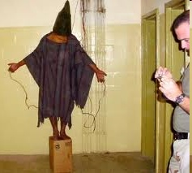
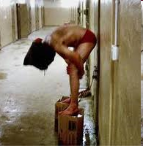
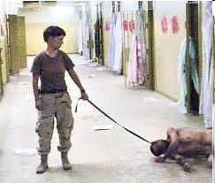
Abu Ghraib

Slide 23
The Lucifer Effect
“A celebration of the human mind’s infinite capacity to make us behave kind or cruel, nice or bad, etc.” – Dr. Phil Zimbardo
Seven social processes that grease the slippery slope of evil:
Mindlessly taking the first small step
Dehumanization of others
De-individuation of self (anonymity)

Slide 24
Lucifer Effect
Diffusion of personal responsibility
Blind obedience to authority
Uncritical conformity to group norms
Passive tolerance of evil through inaction or indifference and that particularly in new or unfamiliar situations

Slide 25
You volunteer to participate in a psychology experiment.
On arrival, you sit at a table and are asked to undertake a series of dull, meaningless tasks (turning pegs in a board) for approximately at hour.
Afterward, the experimenter convinces you to write an essay about the virtues of the tasks you had performed by describing them as highly worthwhile, interesting, and educational.
You were paid either $1 or $20 to do this.
You are then asked to privately rate your enjoyment of the tasks on a questionnaire.
After which amount do you believe your actual enjoyment ratings would be higher – $1 or $20? Why?
Festinger & Carlsmith (1956)

Slide 26
Actions Can Affect Attitudes
Why do actions affect attitudes? One explanation is that when our attitudes and actions are opposed, we experience tension. This is called cognitive dissonance.
To relieve ourselves of this tension we bring our attitudes closer to our actions (Festinger, 1957).
Notes:
OBJECTIVE 5| Explain how the foot-in-the-door phenomenon, role-playing, and cognitive dissonance illustrate the influence of actions on attitudes.

Slide 27
Cognitive Dissonance
Daily Show – Stewart on Republican Cognitive Dissonance
http://www.cc.com/video-clips/co5t5z/the-daily-show-with-jon-stewart-bad-credit
Trump vs. Trump
https://www.youtube.com/watch?v=WpKiP_gmDS8

Slide 28
Social Influence
The greatest contribution of social psychology is its study of attitudes, beliefs, decisions, and actions and the way they are molded by social influence.
NON SEQUITER © 2000 Wiley. Dist. by Universal
Press Syndicate Reprinted with Permission

Slide 29
The Chameleon Effect (maybe should be named the Mimic Octopus Effect)
Conformity: Adjusting one’s behavior or thinking to coincide with a group standard (Chartrand & Bargh, 1999).

Slide 30
Conformity & Obedience
Behavior is contagious, modeled by one followed by another. We follow behavior of others to conform.
Other behaviors may be an expression of compliance (obedience) toward authority.
Conformity Obedience
Notes:
OBJECTIVE 6| Describe the chameleon effect, and give an example of it.

Slide 31
Group Pressure & Conformity
Suggestibility is a subtle type of conformity, adjusting our behavior or thinking toward some group standard. (Asch, 1955)
Notes:
OBJECTIVE 7| Discuss Asch’s experiments on conformity, and distinguish between normative and informational social influence.

Slide 32
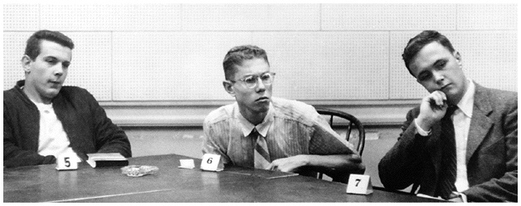
Group Pressure & Conformity
An influence resulting from one’s willingness to accept others’ opinions about reality.
William Vandivert/ Scientific American

Slide 33
John Berry (1967)
Variation of Asch to study whether conformity rates among the Temne in Sierra Leone in Africa and the Inuits of Baffin Island in Canada could be linked to social norms and socialization practices.
Results: the Temne, agricultural economy, high conformity levels. They emphasize obedience in child-rearing practices because the culture is dependent on cooperation in farming.
The Inuits are hunters and often hunt alone. Child-rearing practices emphasize self-reliance. This could perhaps explain why the Inuits tend to conform less

Slide 34
Conditions that Strengthen Conformity
One is made to feel incompetent or insecure.
The group has at least three people.
The group is unanimous.
One admires the group’s status and attractiveness.
One has no prior commitment or response.
The group observes one’s behavior.
One’s culture strongly encourages respect for a social standard.

Slide 35
Reasons for Conformity
Normative Social Influence: Influence resulting from a person’s desire to gain approval or avoid rejection. A person may respect normative behavior because there may be a severe price to pay if not respected.
Informative Social Influence: The group may provide valuable information, but stubborn people will never listen to others.

Slide 36
Informative Social Influence
Baron and colleagues (1996) made students do an eyewitness identification task. If the task was easy (lineup exposure 5 sec.), conformity was low in comparison to a difficult (1/2 sec. exposure) task.

Slide 37
Informative Social Influence
Baron et al., (1996)

Slide 38
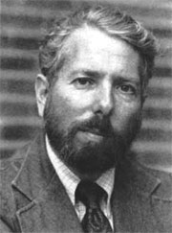
Obedience
People comply to social pressures. How would they respond to outright command?
Stanley Milgram designed a study that investigates the effects of authority on obedience.
Courtesy of CUNY Graduate School and University Center
Stanley Milgram
(1933-1984)
Notes:
OBJECTIVE 8| Describe Milgram’s experiments on obedience, and outline the conditions in which obedience was highest.

Slide 39
Milgram’s Study
Both Photos: © 1965 By Stanley Miligram, from the
film Obedience, dist. by Penn State, Media Sales

Slide 40
Milgram’s Study: Results

Slide 41
Milgram’s Obedience to Authority

Slide 42
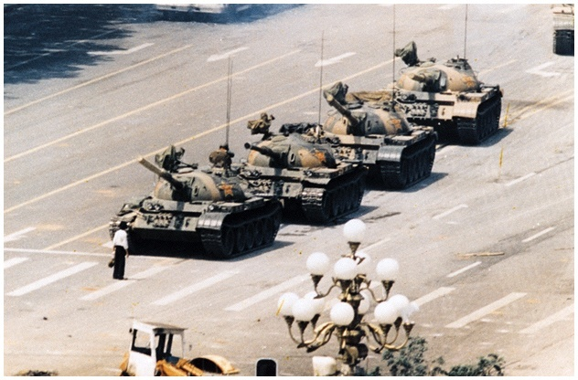
Individual Resistance
A third of the individuals in Milgram’s study resisted social coercion.
AP/ Wide World Photos
An unarmed individual single-handedly
challenged a line of tanks at Tiananmen Square.

Slide 43
Lessons from the Conformity and Obedience Studies
In both Asch's and Milgram's studies, participants were pressured to follow their standards and be responsive to others.
In Milgram’s study, participants were torn between hearing the victims pleas and the experimenter’s orders.
Notes:
OBJECTIVE 9| Explain how the conformity and obedience studies can help us understand our susceptibility to social influence.

Slide 44
Group Influence
How do groups affect our behavior? Social psychologists study various groups:
One person affecting another
Families
Teams
Committees

Slide 45
Individual Behavior in the Presence of Others
Social facilitation: Refers to improved performance on tasks in the presence of others. Triplett (1898) noticed cyclists’ race times were faster when they competed against others than when they just raced against the clock.
Michelle Agnis/ NYT Pictures
Notes:
OBJECTIVE 10| Describe conditions in which the presence of others is likely to result in social facilitation, social loafing, or deindividuation.

Slide 46
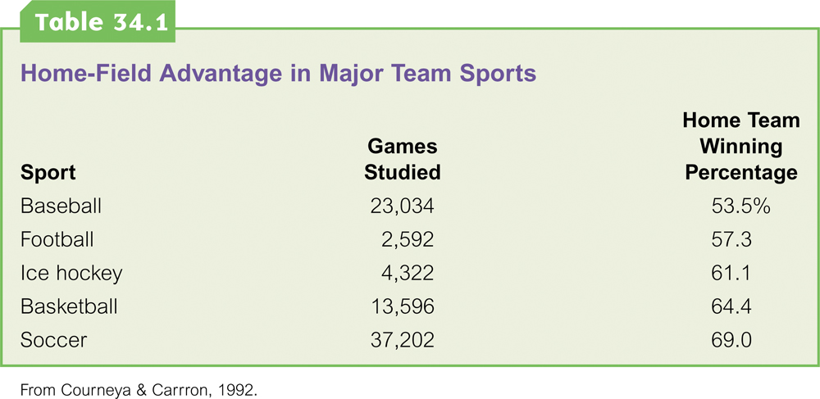
Social Facilitation

Slide 47
Social Loafing
The tendency of an individual in a group to exert less effort toward attaining a common goal than when tested individually (Latané, 1981).

Slide 48
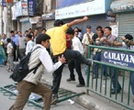
Deindividuation
The loss of self-awareness and self-restraint in group situations that foster arousal and anonymity.
Mob behavior

Slide 49
Effects of Group Interaction
Group Polarization enhances a group’s prevailing attitudes through a discussion. If a group is like-minded, discussion strengthens its prevailing opinions and attitudes.
Notes:
OBJECTIVE 11| Discuss how group interaction can facilitate group polarization and groupthink.

Slide 50
Groupthink
A mode of thinking that occurs when the desire for harmony in a decision-making group overrides the realistic appraisal of alternatives.
Attack on Pearl Harbor
Kennedy and the Cuban Missile Crisis
Watergate Cover-up
Chernobyl Reactor Accident

Slide 51
Power of Individuals
The power of social influence is enormous, but so is the power of the individual.
Non-violent fasts and appeals by Gandhi led to the independence of India from the British.
Margaret Bourke-White/ Life Magazine. © 1946 Time Warner, Inc.
Gandhi
Notes:
OBJECTIVE 12| Identify the characteristic common to minority positions that sway majorities.

Slide 52
Hindsight Bias
After learning an outcome, the tendency to believe that we could have predicted it beforehand may contribute to blaming the victim and forming a prejudice against them.

