Slide 1
Social Identity (and Categorization) Theory
Henri Tajfel
3biii – Evaluate Social Identity Theory, making reference to relevant studies

Slide 2
Social Identity Theory - Henri Tajfel
Assumes people try to improve self-image/esteem thru personal accomplishment & their social identity
Small groups are formed in society according to common interests
Individuals will then identify with those small groups on a personal level – source of pride
People belong to many groups and each varies in importance to one’s self-concept

Slide 3
SIT cont’d
Group schemas tell us what to think, feel, and do in particular contexts
Once identified these behaviors become stereotypes of in-group normative behavior
Distinctions are made between in-group and out-group based solely on group membership
Creates “us vs. them” distinctions between in- and out-groups
In-groups are always favored

Slide 4
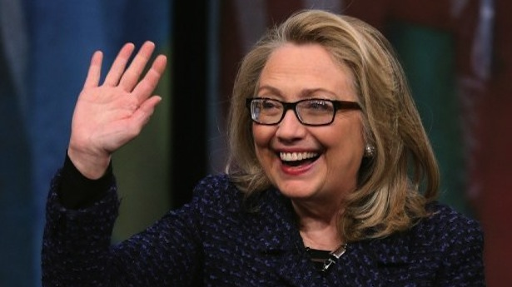
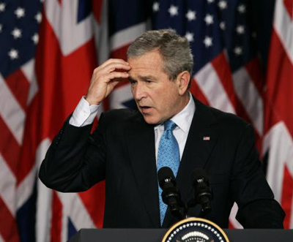
For example

Slide 5
How many of you have criticized a parent this week?
How would you react if someone else, not a relative criticized your parents?
How many of you whine and complain about UAIS?
How do you react when people who don’t go here criticize this program?

Slide 6
Tajfel study (1970)
[Aim] | To test the Social Identity Theory.
[Proc.] | 48 boys were assigned at random to 2 groups based on their preference between Klee or Kandinsky’s art work. Asked to rate in-group and out-group based on traits e.g. like-ability.
[Find.] | Tajfel found that the out-group was rated less likeable, but never actually disliked.
[Concl.] | There seems to be a preference of the in-group over out-group, however it is not clear that they make social comparisons to enhance either self-esteem. Later research – Social identity does not account for intergroup conflict. In the absence of competition, social comparison can be positive.
[Eval.] | Supports Social Identity Theory. Showed the formation and the features of SIT. Ecological validity: Low, lab conditions. Meaningless groups. Controlled environment removed confounding variables.

Slide 7
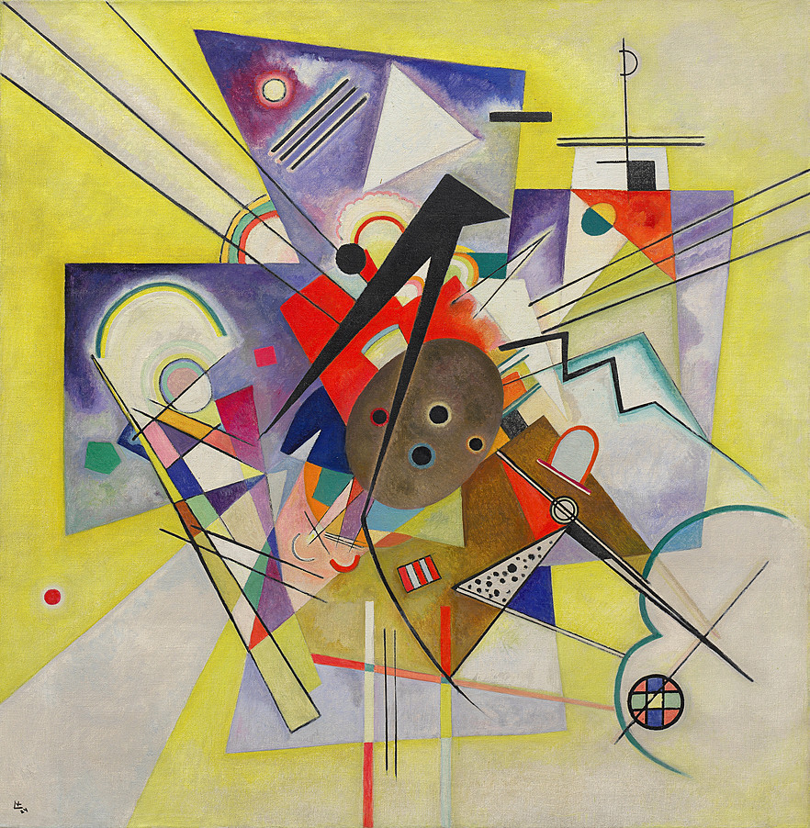
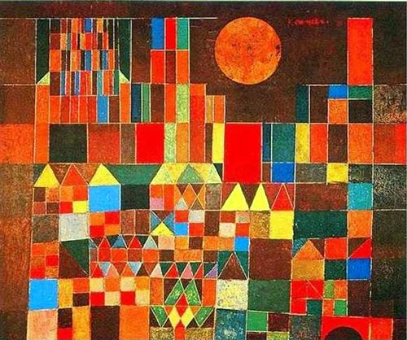
Klee & Kandinsky

Slide 8
Cialdini (1976)
[A] | Demonstrate social comparison with college football supporters.
[P] | Observed what college students wear to school the next day after their football game.
[F] | Students wore apparel with the representative colour of their school the day after the football game if the school won.
[C] | Result of positive self-concept results in a bias intergroup comparison. Having a positive representation of your social group (Positive distinctiveness).

Slide 9
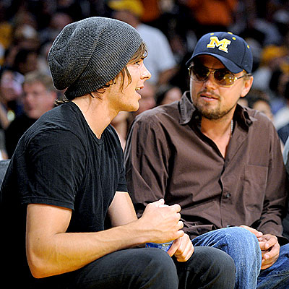
C’mon I had to…

Slide 10
Nass, Fogg, Moon Study (1995)
[A] | Social Identity will form w/randomly assigned team
[P] | 28 students (equal men &women) initiated into the Blue Group. Then randomly assigned to answer questions on blue or green computers. Blue-blue was “blue team” vs. blue indivs. working on green computer
[F] | Blue team changed their answers to match the team computer answers more often than individuals
[C] | Suggests a SI has formed between blue members and blue computer Suggests that even in absence of other people, SIs can still form

Slide 11
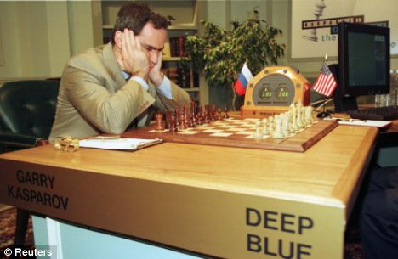

Slide 12
Zimbardo – Stanford Prison Study
Coming Soon to Psych Class Near You!

Slide 13
And Now…This
https://www.youtube.com/watch?v=AJKfs4ZnbNE
https://edpuzzle.com/classes/56a044379d0f10424175f6c5

Slide 14
Strengths of SIT
Lots of empirical research supports it
Widely applicable
Humans actively engaged in sense of self
Creates norms & culture for people to adhere and belong to
Explanation for stereotyping and discrimination

Slide 15
Limitations of SIT
Describes but can’t predict
Personal identity can be stronger –
people do reject their group
Above – esp. w/ people of high self-esteem
Reductionist – doesn’t account for situational factors
Research is often lab based, low EV

Slide 16
Hey, we were talking about art earlier, so that’s my excuse to show you this…
http://distractify.com/trending/2016/02/01/mark-hairstylist-work-of-art

Slide 17
Social Categorization Theory – SCT (John Turner, 1985/87)
Less emphasis on self-esteem, more emphasis on how categories become the cognitions that guide group behavior
Categories help individuals see in-groups as more diverse than they are and out-groups as more similar than they are
Creating categories requires depersonalization
Example – aggression in sports is depersonalized as team behavior
Not to be confused with dehumanization or deindividuation

Slide 18
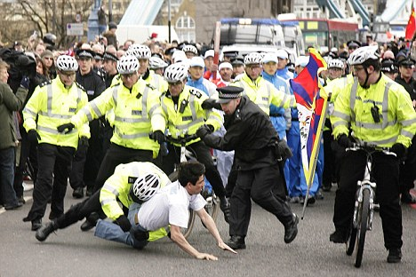
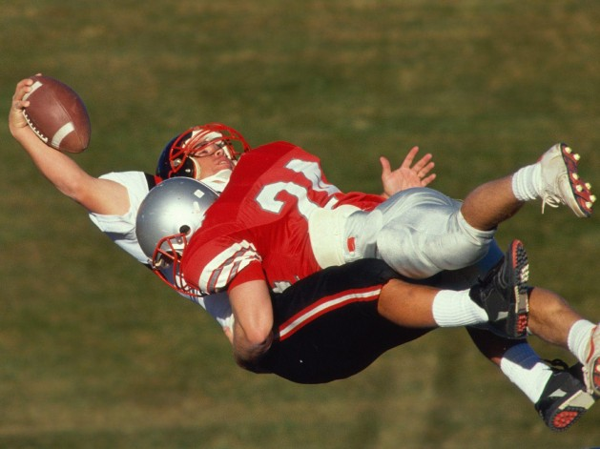
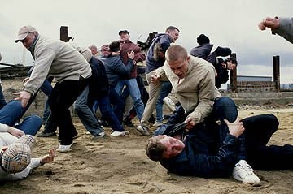

Slide 19
SCT cont’d
Says we view groups in terms of prototypes or norms
They are cognitive representations (aka?), characteristics of a group’s attitudes, beliefs and behaviors based on info we have
Most salient about groups in a specific context – nation, religion etc
But, stereotyping is best framed as in-group preference rather than out-group disfavor (Fiske, 2004)

Slide 20
So What?
Help us understand how in-groups shape representations of our selves (etic)
But the “self” means different things in individualist vs. collectivist cultures (emic)
Social self really exists on 3 levels
1. Individual – your self is unique…just like everyone else
2. Relational – self exists in terms of harmonious relations…I love you, you love me
3. Collective – Self fits in depersonalized categories of groups with symbolic value to the person…I’m a neo-Gothic, post-Existentialist, new-wave, hipster

Slide 21
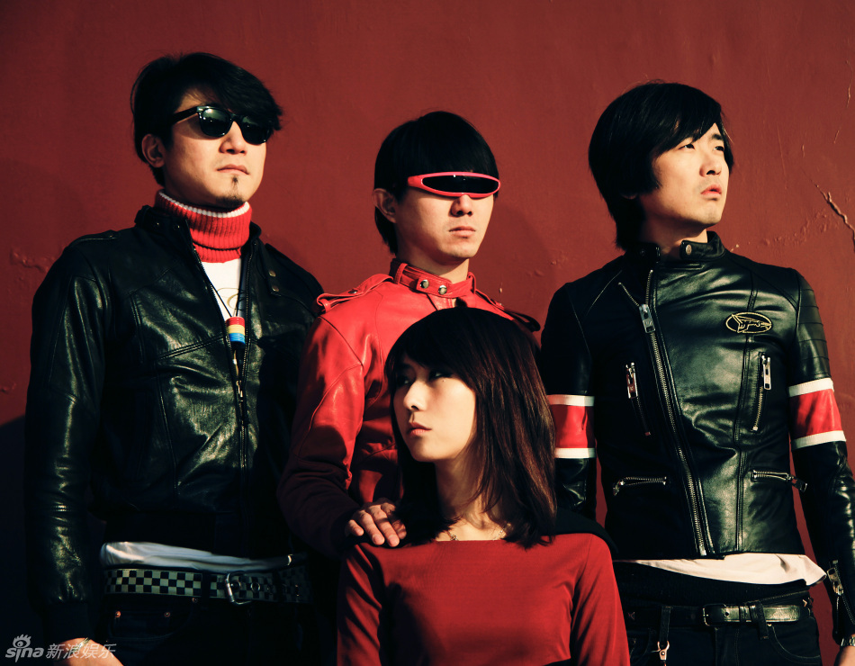

Slide 22
So What?
SIT & SCT explain level 3 but more for individualist than collectivist cultures
In collectivist cultures, social self exists at the relational level & are personalized
Designed to maintain in-group harmony and cooperation
Each culture is emic, but generally collectivist cultures’ social identities are more relational than categorical

Slide 23
Ok…seriously, so what?
Identifying with a culture evolved over time to maximize individual survival
One aspect of culture is mobility – high correlates with individualism, low with collectivism
Little chance at mobility? In your interest to behave in ways that promote harmony – don’t steal a chicken cuz where you gonna run?
Greater mobility allows you to find your place that allow your interests & preferences to define your relationship to the group (groups still important)
Ultimately social identity is etic but it’s emphasis is emic

