Slide 1
Social Cognitive Theory
- From Albert Bandura (1960s)
- First called Social Learning Theory
- Says children and others learn through observation (modeling)
- May imitate what they see vicariously (e.g., on television)
- Empirical evidence: Bobo doll studies, others—generally support basic premise plus additional assumptions, e.g.,
Rewarded and unpunished violence more likely to be imitated.
Punished violence less likely to be imitated.

Slide 2
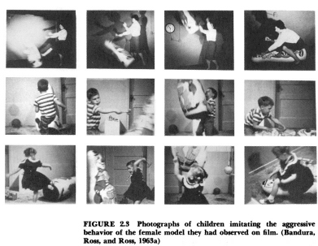
Bobo Doll Studies

Slide 3
Bobo Doll Studies—thoughts??

Slide 4
Observational Learning
Bandura hypothesized a four-step pattern that combined a cognitive and operant view of learning.
Attention
notices something in the environment
Retention
remembers what was noticed
produces an action that is a copy of what was noticed
Reproduction
consequence changes the probability the behavior will be emitted again
Motivation

Slide 5
Social Cognitive Theory:
- Explains how people acquire and maintain certain behavioral patterns, while also providing the basis for intervention strategies.

Slide 7
Social Cognitive Theory:
- Explains how people acquire and maintain certain behavioral patterns, while also providing the basis for intervention strategies.
- Human behavior is explained in terms of a triadic, dynamic, and reciprocal model in which behavior, personal factors, and environmental influences all interact. An individual’s behavior is uniquely determined by these interactions.

Slide 8
Social Cognition
Bandura developed the concept of reciprocal determinism to account for human behavior.
OVERT BEHAVIOR
PERSONAL FACTORS
ENVIRONMENT
Personal Examples?

Slide 9
Social Cognitive Theory: Reciprocal Determinism
This is a broad assumption that acknowledges behavior is dynamic and is a consequence of the continuous interaction between the person, past events and the current environment
Translation?
- This is not empirically tested and provides a nice out!

Slide 10
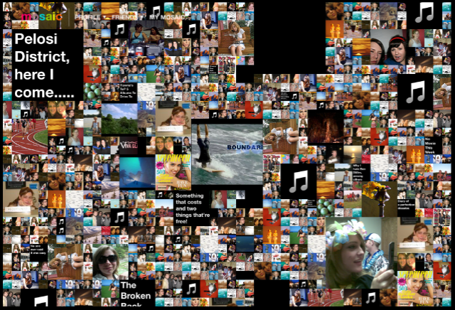
SCT: Environments and Situation
- The environment is composed of the social environment:
Family, friends, peers at work or in the classroom
& the physical
environment

Slide 11
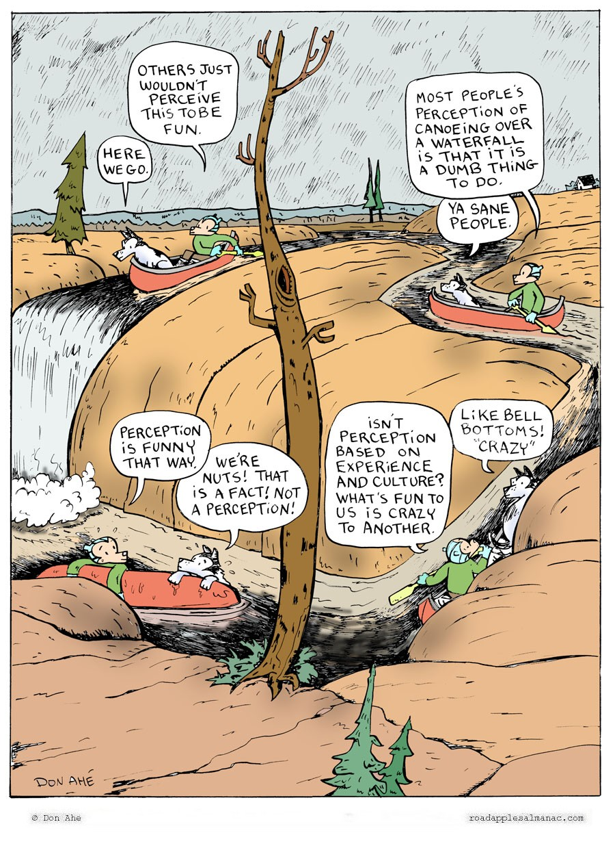
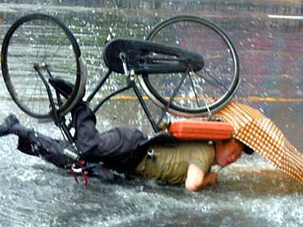
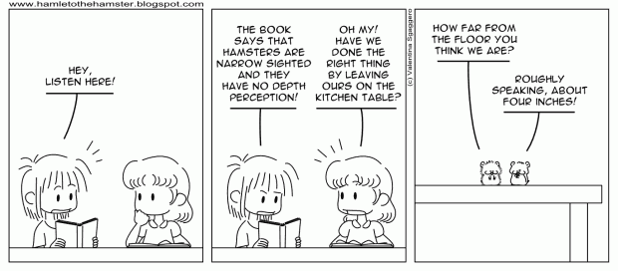
Environments and Situation
- Situation refers to the person’s perception of the environment
- Does this imply that changing the environment changes situations?
- In other words does perception define reality?

Slide 12
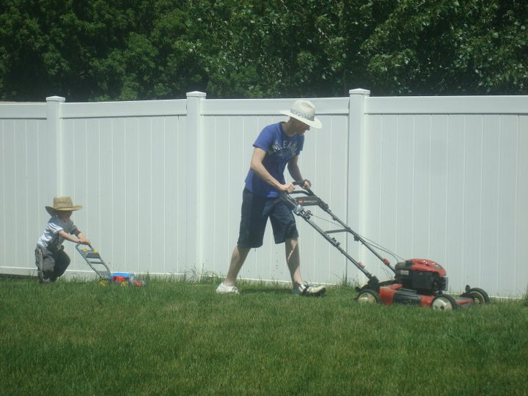
SCT: Behavioral Capability
- If a person is to perform a behavior he or she must know what the behavior is (knowledge of the behavior) and have the skills to perform it.
- Can a person develop a behavioral capability through observational learning?

Slide 13
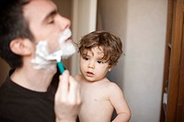
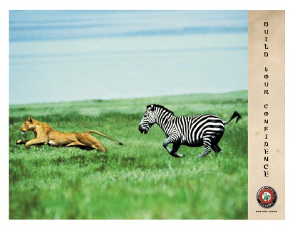
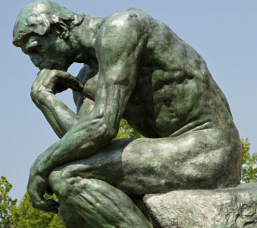
Personal Factors Influencing Behavior Include Having the Capability to:
- Symbolize behavior
- Anticipate the outcomes of a behavior
- Learn by observing others
- Have confidence in performing a behavior (including overcoming any barriers to performing the behavior)
- Self-determine or self-regulate behavior
- Reflect and analyze experience

Slide 14
Importance of Human Agency
- A key mechanism through which the individual contributes to this triad is:
Personal agency (act independently & make choices)
Proxy agency (one more capable than the individual guides him/her)
Collective agency (ppl pool together to achieve things they cannot on their own)
- Key to human agency is the person’s belief in their personal efficacy
- Unless people believe they can produce desired results to their actions they have little incentive to act or to persevere in the face of difficulty

Slide 15
Self-Efficacy
Self-reflection is a second human quality and is expressed in the concept of self-efficacy.
“Self-efficacy is the belief in one’s capabilities to organize and execute the sources of action required to manage prospective situations.” (Bandura, 1986)
Plus, the ability to do it.
Reading pg. 2 for details

Slide 16
Social Cognitive Theory: Self-Efficacy
The most important pre-requisite for behavior change
How important do you
think self-efficacy is
and why?

Slide 17
Self-Efficacy
How are Self-Efficacy Beliefs Created? (Reading pg. 3)
Previous experience aka mastery experience
Vicarious experience of observing others
Social persuasions received from others
Somatic/emotional states: anxiety, stress, arousal and mood

Slide 18
Self-Efficacy
Self-efficacy impacts (reading pg. 3):
The choices we make
The effort we put forth
How long we persist when we confront obstacles (especially in the face of failure)
How we feel about ourselves, others, the task, etc.

Slide 19
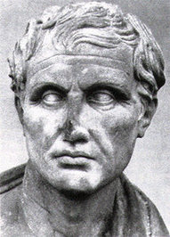
ToKonnection
“They are able who think they are able” - Virgil
“A person who doubts himself is like a man who would enlist in the ranks of his enemies and bear arms against himself. He makes his failures certain by himself being the first person to be convinced of it.” – Alexander Dumas
“Whether you think you can, or you think you can't--you're right.” ― Henry Ford

Slide 20
Social Cognitive Theory: Reinforcement
- Reinforcements are applied to reward positive behaviors and sanction negative behaviors
- Direct reinforcement
- Vicarious reinforcement
- Self reinforcement
- Give some examples of reinforcement from your work/life

Slide 21
Self-Regulation
Self-regulation is a third human capability and has several sub-functions:
Goal-setting
Self-observation and monitoring
Performance judgment and evaluation
Self-reaction (e.g., self-satisfaction, self-worth, distress)

Slide 22
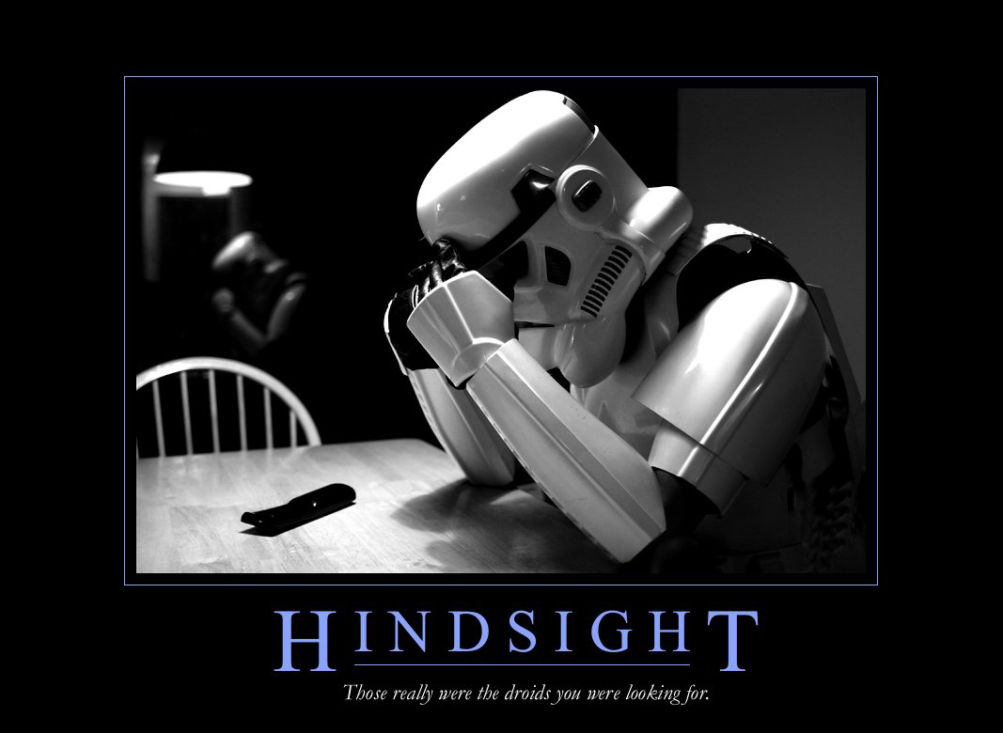

Slide 23
Social Cognitive Theory: Outcome Expectations
- A person learns that certain outcomes occur in a given situation and expects them to occur when that situation presents itself again ad the person performs similarly.
- Expectations guide behavior
- Expectations learned in 4 ways:
Performance attainment
Vicarious experience
Hearing from others or social persuasion
Physiological arousal

Slide 24
Social Cognitive Theory: Outcome Expectancies
Expectancies are the values a person places on a particular outcome
Hedonic principle – a person will choose to maximize a positive outcome over a negative outcome
Key in intervention for motivating adoption of new behaviors
Physical activity
Smoking

Slide 25
Social Cognitive Theory: Self-Control of Performance
The key is the ability of the individual to engage in behavior to achieve a goal.

Slide 26
Social Cognitive Theory: Management of Emotional Arousal
Excessive emotional arousal inhibits learning

Slide 27
Social Cognition
Bandura’s basic position is that
“People's level of motivation, affective states, and actions are based more on what they believe than on what is objectively the case.”

Slide 28
Social Cognitive Theory:
Reciprocal Determinism
Environments and Situation
Observational Learning
Behavioral Capability
Reinforcement
Outcome Expectations
Outcome Expectancies
Self-Efficacy
Self-Control of Performance
Management of Emotional Arousal

Slide 29
Recap Major Constructs in SCT and Implications for Intervention:
Environment: Factors physically external to the person; Provides opportunities and social support
Situation: Perception of the environment; Correct misperceptions and promote healthful forms
Behavioral capability: Knowledge and skill to perform a given behavior; Promote mastery learning through skills training
Expectations: Anticipatory outcomes of a behavior; Model positive outcomes of healthful behavior
Expectancies: The values that the person places on a given outcome, incentives; Present outcomes of change that have functional meaning
Self-control: Personal regulation of goal-directed behavior or performance; Provide opportunities for self-monitoring, goal setting, problem solving, and self-reward

Slide 30
Major Constructs and Implications (continued)
Observational learning: Behavioral acquisition that occurs by watching the actions and outcomes of others’ behavior; Include credible role models of the targeted behavior
Reinforcements: Responses to a person’s behavior that increase or decrease the likelihood of reoccurrence; Promote self-initiated rewards and incentives
Self-efficacy: The person’s confidence in performing a particular behavior; Approach behavioral change in small steps to ensure success
Emotional coping responses: Strategies or tactics that are used by a person to deal with emotional stimuli; Provide training in problem solving and stress management
Reciprocal determinism: The dynamic interaction of the person, the behavior, and the environment in which the behavior is performed; Consider multiple avenues to behavioral change, including environmental, skill,and personal change.

