Slide 1
Intro to Psychology
2018-19

Slide 2
What is Psychology?
Psychology is the study of behavior and mental processes

Slide 3
The Need for Psychological Science
Intuition & Common Sense
Many people believe that intuition and common sense are enough to bring forth answers regarding human nature.
Intuition and common sense may aid queries, but they are not free of error.

Slide 4
Limits of Intuition
Personal interviewers may rely too much on their “gut feelings” when meeting with job applicants.
Gladwell:
CEO’s over 6’ and male
“Aggressive sounding” surgeons sued more
NYC Philharmonic sexist, now over 50% female
“The Voice” on NBC
Taxi/ Getty Images

Slide 5
Errors of Common Sense
Try this !
Fold a piece of paper (0.1 mm thick) 100 times. How thick will it be?
800,000,000,000,000 times the distance between the sun and the earth.

Slide 6
Hindsight Bias
Hindsight Bias is the “I-knew-it-all-along” phenomenon.
After learning the outcome of an event, many people believe they could have predicted that very outcome.
“Prediction is very difficult, especially about the future” – Physicist Niels Bohr.
Notes:
OBJECTIVE 1| Describe hindsight bias and explain how it can make research findings seem like mere common sense.
“Anything seems commonplace, once explained.” Dr. Watson to Sherlock Holmes.
Two phenomena – hindsight bias and judgmental overconfidence – illustrate why we cannot rely solely on intuition and common sense.

Slide 7
Common Sense
Conclusions based solely on personal experience and sensible logic
Can lead to incorrect conclusions

Slide 8
One More Example
Burak’s Common Sense Quiz

Slide 9
Overconfidence
Sometimes we think we know more than we actually know.
Here is an example of a 5 letter anagram
nuhod
The answer is hound
How long do think it would take you to do a similar 5 letter anagram?
Anagram
SAHOC
CHAOS
WRTEH
THREW
People said it would take about 10 seconds, yet on average they took about 3 minutes (Goranson, 1978).
RABEG
BARGE
Overconfidence Fail - Cracked
Notes:
OBJECTIVE 2| Describe how overconfidence contaminates our everyday judgments.

Slide 10
Sampling
A sample that fairly represents a population because each member of the population has an equal chance of being included is called…
Other types of sampling?
Opportunity, Self-Selected, Snowball, Stratified
Strengths & Limitations of these?

Slide 11
Experimental Design
Independent measures
Matched-pairs
Repeated measures

Slide 12
Validity & Reliability
Reliable = replicable
Construct Validity
Internal Validity
External Validity
Population
Ecological

Slide 13
Ecological Validity
Ecological Validity: Ecological Validity is the degree to which the behaviors observed and recorded in a study reflect the behaviors that actually occur in natural settings.
In addition, ecological validity is associated with "generalizability". Essentially this is the extent to which findings (from a study) can be generalized (or extended) to the "real world".
In virtually all studies there is a trade-off between experimental control and ecological validity.

Slide 14
The more control psychologists exert in a study, typically the less ecological validity and thus, the less they may be able to generalize.
For example, when we take people out of their natural environment and study them in the lab, we are exerting some control over them and, as a result, possibly limiting how much we can generalize the findings to all people in natural settings.

Slide 15
Biases
Sampling bias – always college students e.g.
Researcher’s biases can influence the way a question is worded or asked (leading, order).
May subtly influence the participants too
People are not always honest (social desirability)
Participant variability – characteristics of the sample affect the dependent variable

Slide 16
Confirmation Bias
A tendency to search for information that confirms a preconception
Means to lower confirmation bias
Objective observation
Critical thinking
Pygmalion Effect (Rosenthal & Jacobson, 1968 pg. 18)

Slide 17
Demand Characteristics aka Hawthorne Effect
Tendency of research subjects to behave in a certain way because they know they are being observed, or they try to guess the aim, or they believe they know what the researcher “wants” (Orne, 1962 pg. 29)
Can be reduced by naturalistic observation & blind studies

Slide 18
False Consensus Effect
How many of you are left-handed?
Everyone jot down - how many left-handed people in the US by %?
A tendency to overestimate the extent to which others share our beliefs and behaviors.

Slide 19
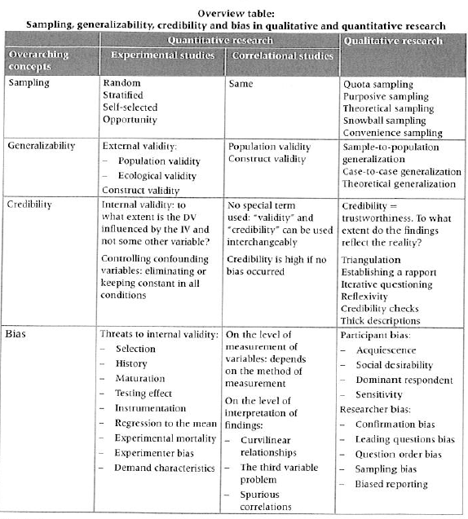

Slide 20
Hypothesis
A Hypothesis (H₁)is a testable prediction, often prompted by a theory, to enable us to accept, reject or revise the theory.
People with low self-esteem will feel more depressed when receiving an artificially low score on an intelligence test.
For the hypothesis to be accepted, it must be tested and the results replicated

Slide 21
Null Hypothesis
A Null Hypothesis (H₀) simplistically is the opposite of the H₁.
The null hypothesis (H₀) is a hypothesis which the researcher tries to reject or nullify.
The 'null' often refers to the common view of something, while the alternative hypothesis is what the researcher really thinks is the cause of a phenomenon.
An experiment conclusion always refers to the null, rejecting or accepting H₀ rather than H₁.

Slide 22
Example
Experimental H₁: Males will flirt with members of the opposite sex that are either approximately the same level of physical attractiveness as themselves or above, whereas females will flirt with members of the opposite sex who are either approximately of the same level of attractiveness as themselves or lower.
Null H₀: An individual’s level of physical attractiveness will not influence with whom the individual chooses to flirt with.

Slide 23
Independent Variable
The variable that the researcher will actively manipulate and, if the hypothesis is correct, that will cause a change in the dependent variable
The experimental variable which causes something to happen
The “cause variable”
The variable manipulated by the experimenter

Slide 24
Dependent Variable
The variable that should show the effect of the independent variable
The “effect variable”
The outcome of the experiment
The variable being measured

Slide 25
Experimental Group
The participants in an experiment who are exposed to the independent variable
Also called the experimental condition
The group being studied and compared to the control group

Slide 26
Control Group
The participants in an experiment who are not exposed to the independent variable
Results are compared to those of the experimental group
Also called the control condition

Slide 28
Extraneous/Confounding Variables
Variables, other than the independent variable, which could inadvertently influence the dependent variable
These variables should be controlled for in order to draw a true, cause-effect relationship in the experiment.
Many extraneous variables can be eliminated through random assignment.

Slide 29
Random Assignment
A procedure for creating groups that allows the researcher to control for individual differences among research participants.
Assigning participants to the control and experimental groups by chance
Each participant should have an equal chance of being assigned into either group.

Slide 30
Blind procedure
An experimental procedure where the research participants are ignorant (blind) to the expected outcome of the experiment
Sometimes called single blind procedure

Slide 31
Double Blind Procedure
A research procedure in which both the data collectors and the research participants do not know the expected outcome of the experiment.
Both groups are ignorant (blind) to the experiment’s purpose or expected results

Slide 32
Placebo
A non-active substance or condition administered instead of a drug or active agent
Many times an inactive pill that has no known effect
Given to the control group

Slide 33
Placebo Effect
Experimental results caused by expectations alone
In other words – the substance has no inherent qualities that lead to benefits, but belief that it does equates to positive results anyway
Nocebo effect – when negative expectations can get side effects even though it’s an inert substance
Moseley, 2002 – arthroscopic knee study

Slide 34
Ethics: Human Research (Six Basic Principles)

Slide 35
1. Informed Consent
Participants must be informed, in advance, about:
the general nature of the research, and
any potential risk.

Slide 36
2. Deception
Deception is acceptable but…
And you should always do #3 but especially with deception...

Slide 37
3. Debriefing
Participants have a right to receive a complete explanation of the research, aim, and purpose at the end of the study.
This is extremely important if the research involves deception.

Slide 38
4. Withdrawal
Right to leave study at any time, including after they’ve participated by withdrawing their data

Slide 39
5. Confidentiality
Individual data about research participants should never be discussed or released.
How does this work with case studies?

Slide 40
6. Protection from Harm and Discomfort
Studies involving harm or discomfort may be conducted only under certain circumstances, and only with the informed consent of the participants.
Includes mental and physical protection

Slide 41
FAQ
Q. Why do psychologists study animals?
A: Studying animals gives us the understanding of many behaviors that may have common biology across animals and humans.
D. Shapiro, © Wildlife Conservation Society
Notes:
OBJECTIVE 23| Explain why psychologists study animals, and discuss the ethics of experimentation with both animals and humans.

Slide 42
FAQ
Q. Is it ethical to experiment on animals?
A: Yes. To gain insights to devastating and fatal diseases. All researchers who deal with animal research are required to follow ethical guidelines in caring for these animals.

Slide 43
Activity
Watch this video and record noteworthy observations

Slide 44
Observations
Lab vs. Naturalistic
Overt vs. Covert
Participant vs. Non-Participant
Structured vs. Unstructured

Slide 45
Triangulation
An approach used to ensure enough evidence is available to make a valid claim about the results of a study.
Method
Data
Researcher
Theory
Time

Slide 46
Critical Thinking
Methodology
Ethics
Gender
Application
Culture
MEGA-C
These are the areas with which to apply your critical thinking and analysis

Slide 47
Qualitative Methods
Interviews, Observations, Case Studies
Read your chapter (10.2, 10.3 or 10.4) and be prepared to discuss it with others in your group and then teach members of the other groups

Slide 48
Correlational Study
Important NOT to imply a cause and effect relationship between the variables
Correlational study does not determine why the two variables are related--just that they are related.
Correlational studies are helpful in making predictions.

Slide 49
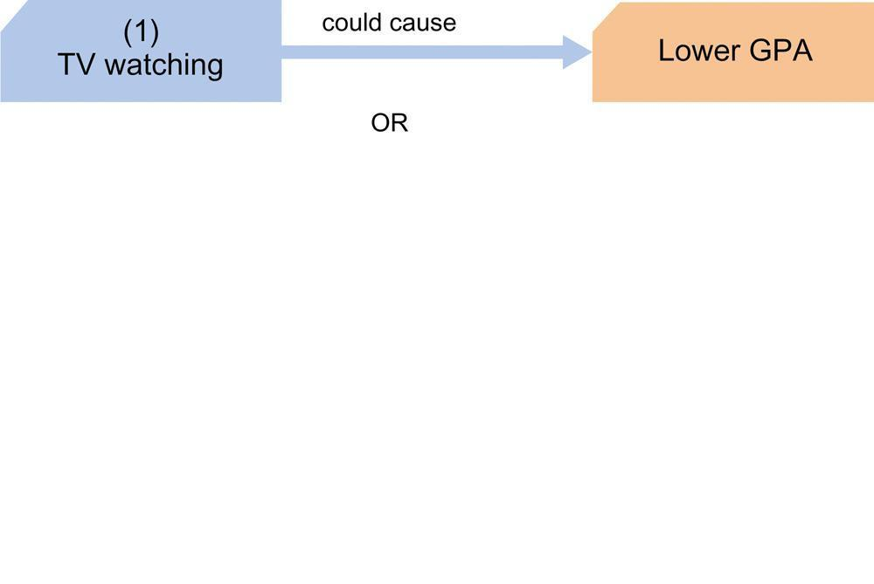

Slide 50
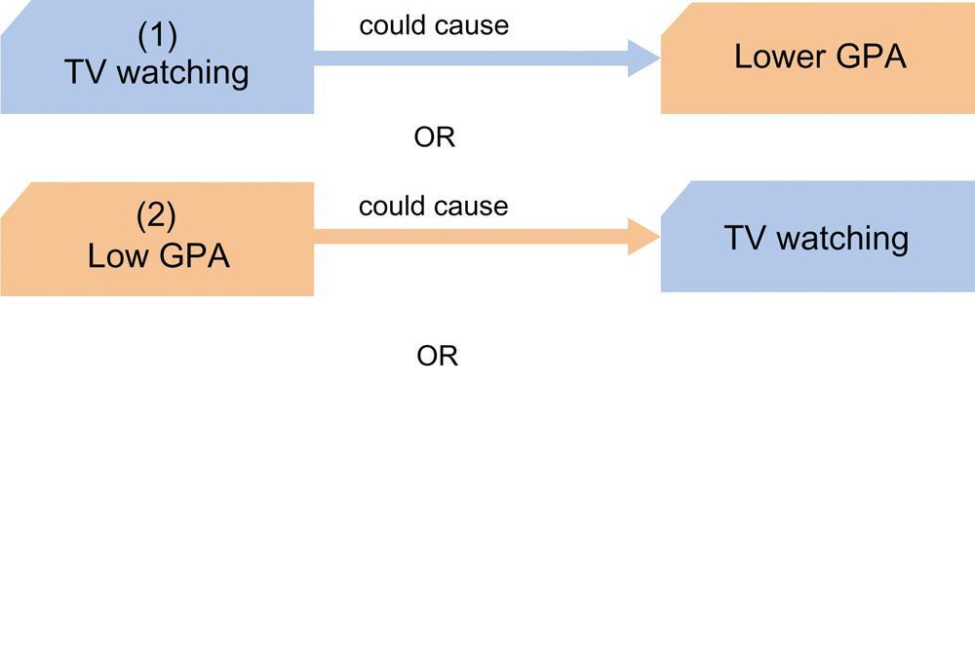

Slide 51
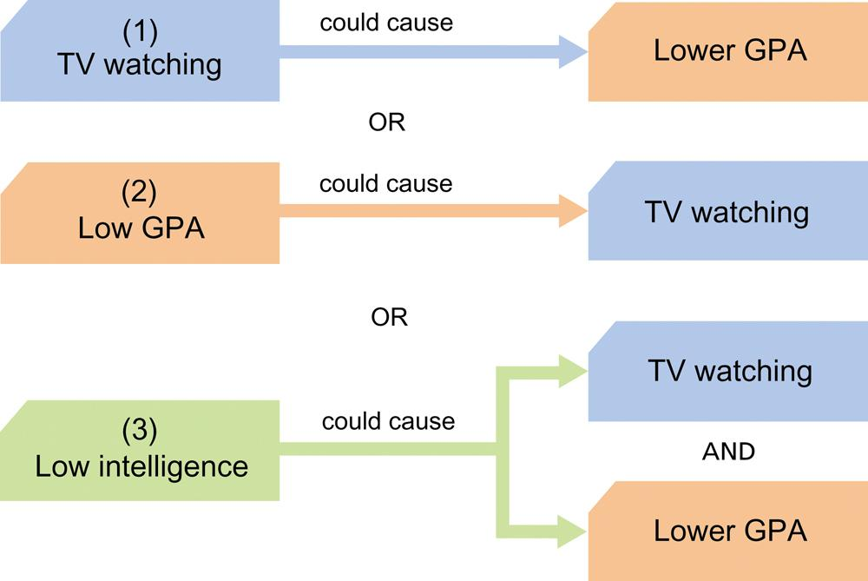

Slide 52
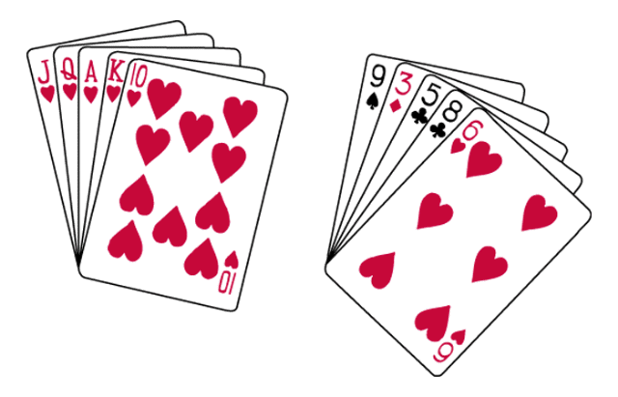
Order in Random Events
Given random data, we look for order and meaningful patterns.
Which of these is more likely to be dealt to you in a poker hand?
Your chances of being dealt either of these hands is precisely the same: 1 in 2,598,960.

Slide 53
Illusory Correlation
The perception of a relationship where no relationship actually exists. A girl wins money on a scratch off ticket when using one specific coin, so she scratches all of her tickets with that coin, believing it's the cause of her win
Why is the number of drownings positively correlated with ice cream sales?
Notes:
OBJECTIVE 10| Describe how people form illusory correlations.

Slide 54
Longitudinal Study
A research technique that follows the same group of individuals over a long period
Can be very expensive and difficult to conduct

Slide 55
Cross-Sectional Study
A research technique that compares individuals from different age groups at one time
Study a number of subjects from different age groups and then compare the results
Cheaper, easier than longitudinal studies, but group differences may be due to factors other than development.

Slide 56
Longitudinal/Cross Sectional Study

