Slide 1
Intro to Cognition & Memory
Models of memory
Multi-Store Model
Sensory Memory
Short-Term Memory
Long-Term Memory
Working Memory Model
Central Executive
Phonological Loop
Episodic Buffer
Visuospatial Sketchpad
Memory Processing
Levels of Processing
Implicit/Explicit

Slide 2
More standards
Schema Theory
Influence on memory encoding, storage, and retrieval
Automatic and non-conscious but can lead to biases in and errors in thinking and memory processes
Can include but not limited to:
Top down & bottom up processing
Pattern recognition
Effort after meaning
Stereotyping

Slide 3
Reliability of Cog. Processes
Reliability of Cognitive Processes
Reconstructive Memory
Confabulation
Schema Processing
False Memories

Slide 4
What is Cognition?
Essentially – thinking, problem solving, perceptions, emotions, memories, language etc. processed in your brain

Slide 5
Principles of Cognitive AtU:
The cognitive approach to understanding behaviour looks at:
cognitive processing (SL and HL)
reliability of cognitive processes (SL and HL)
emotion and cognition (SL and HL)
cognitive processing in the digital world (HL only).
Relevant to all the topics are:
the contribution of research methods used in the cognitive approach to understanding human behaviour
ethical considerations in the investigation of the cognitive approach to understanding human behaviour.

Slide 6
Schemas
Schemas are a way to score knowledge
Schema Theory is a cognitive theory about information processing
People don’t passively accept info
They interpret and integrate info to make sense of their experiences
Can be an unconscious process

Slide 7
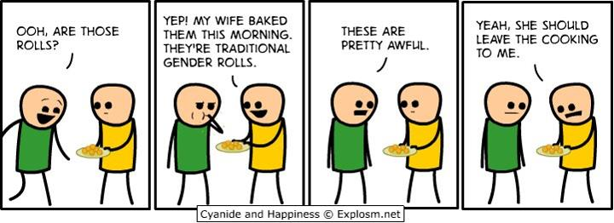

Slide 8
Schemas (bartlett)
Schemas are mental molds into which
we pour our experiences.

Slide 9
Schema Theory
In psych, many theories/studies support this
Most theorize our human schemas develop very early in life, infant cognition begins immediately
Often measured and understood through studying language and grounded in the cultural components language transmits
We’re starting with schema & memory though and will revisit language soon

Slide 10
The Phenomenon of Memory
Definition -
Memory is any indication that learning has persisted over time. It is our ability to store and retrieve information.
Notes:
OBJECTIVE 1| Define memory, and explain how flashbulb memories differ from other memories.

Slide 11
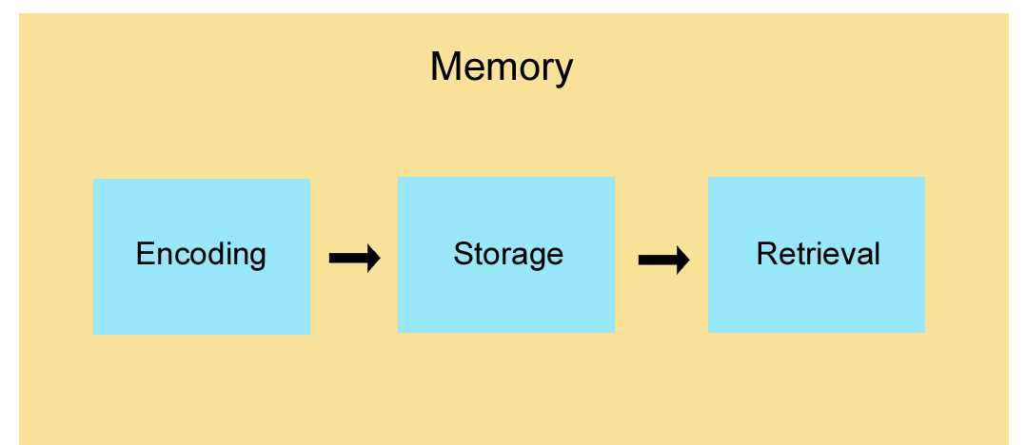
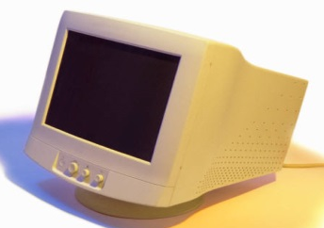
Stages of Memory
Keyboard
(Encoding)
Disk
(Storage)
Monitor
(Retrieval)
Sequential Process

Slide 12
Information Processing
The Atkinson-Schiffrin (1968) three-stage model of memory (aka multi-store model) includes
a) sensory memory, b) short-term memory, and
c) long-term memory.
But it’s now considered an outdated model, most significant for the subsequent research it spawned
Notes:
OBJECTIVE 2| Describe Atkinson-Schiffrin’s classic three-stage model of memory and explain how contemporary model of working memory differs.

Slide 13
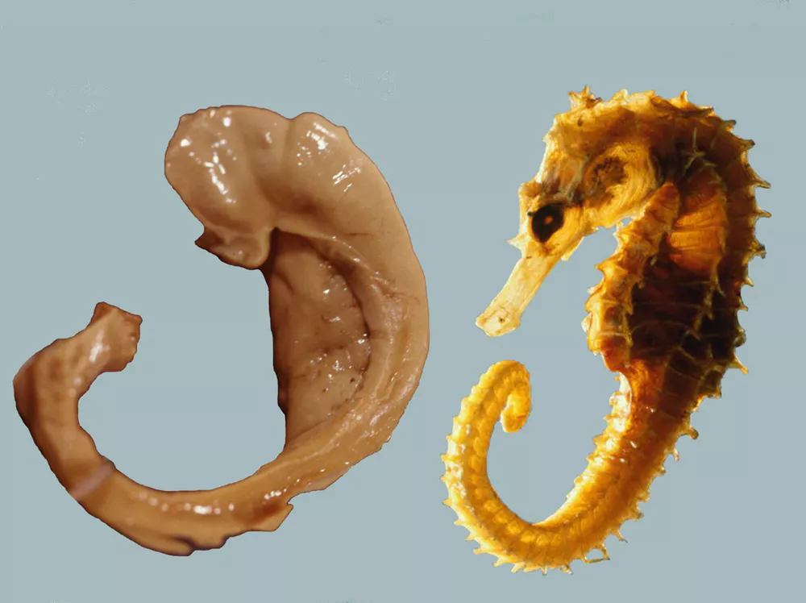
Brain Part - Hippocampus

Slide 14
An example of a Strength
I’m going to show you a list of words.
When you see the recall slide, write down as many as you can, order is not important.

Slide 16
bed

Slide 17
night

Slide 18
rest

Slide 19
awake

Slide 20
toss

Slide 21
tired

Slide 22
dream

Slide 23
wake

Slide 24
night

Slide 25
snooze

Slide 26
blanket

Slide 27
doze

Slide 28
artichoke

Slide 29
slumber

Slide 30
snore

Slide 31
turn

Slide 32
nap

Slide 33
peace

Slide 34
yawn

Slide 35
drowsy

Slide 36
night

Slide 38
Recall

Slide 40
We are more likely to remember things at the beginning or end of a series – how many of you remembered bed, rest, awake or peace, yawn, drowsy?
Glanzer & Cunitz (Primacy-Recency) Serial Position Effect
Unusual or remarkable things though stand out – how many had “artichoke”?
Repetition leads to higher recall as well - how many remembered “night”?
Chunking – who remembered “toss” & “turn”?
Déjà vu – how many of you remembered sleep?
One more exercise – get in a circle
This is called the next-in-line effect

Slide 41
Answers
bed
night
rest
awake
toss
tired
dream
wake
night
snooze
blanket
doze
artichoke
slumber
snore
turn
nap
peace
yawn
drowsy
night

Slide 42
Problems with THAT Model
Some information skips the first two stages and enters long-term memory automatically.
- Space - Time - Frequency - Images
Let’s do an example with images
Since we cannot focus all the sensory information in the environment, we select information (through attention) that is important to us.
- Nose
- Tongue
- Pants
The nature of short-term memory is more complex.

Slide 43
Working Memory
Alan Baddeley (2002) proposes that working memory contains auditory and visual processing controlled by the central executive through an episodic buffer.

Slide 44
Examples
Moonwalking with Einstein
Michael Cole

Slide 45
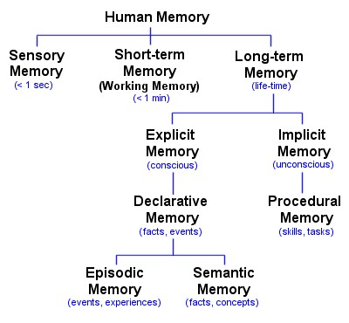

Slide 46
Limitations with Working Memory Model
No clear indication of where or how any of this stuff works
Hippocampus and synapses are involved as is the cortex, amygdala, both hemispheres etc.

Slide 47
Memory is Malleable
Think about our sleep serial position effect, we fill it in with schema
Bartlett – reproductive vs. Reconstructive
Thanks for the Memories reading too
Let’s try another example
Watch the following video – Brain Games

Slide 48
Eyewitness Questions
How many people were involved in the confrontation?
What color was the woman’s jacket?
What color was the thief’s hoodie?
What did the thief take from the old man?
Did you see the thief drop anything?
What was the victim saying?
Do you think you could pick the perpetrator(s) out of a lineup?
Describe the perpetrator(s) as much as you can

Slide 49
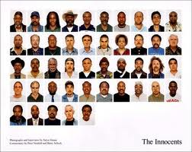
Eyewitness Memroy
Eyewitness identification evidence is the leading cause of wrongful conviction in the United States.

Slide 50
Eyewitness memory
Of the more than 200 people exonerated by way of DNA evidence in the US, over 75% were wrongfully convicted on the basis of erroneous eyewitness identification evidence.

Slide 51
The Innocence Project
Facilitated the exoneration of 351 people who were convicted of crimes they did not commit, as a result of faulty eyewitness evidence (as of 2017).
A number of these cases have received attention from the media.

Slide 52
Loftus!

