Slide 1
Intro to Cognition & Memory
Models of memory
Multi-Store Model
Sensory Memory
Short-Term Memory
Long-Term Memory
Working Memory Model
Central Executive
Phonological Loop
Episodic Buffer
Visuospatial Sketchpad
Memory Processing
Levels of Processing
Implicit/Explicit

Slide 2
More standards
Schema Theory
Influence on memory encoding, storage, and retrieval
Automatic and non-conscious but can lead to biases in and errors in thinking and memory processes
Can include but not limited to:
Top down & bottom up processing
Pattern recognition
Effort after meaning
Stereotyping

Slide 3
Reliability of Cog. Processes
Reliability of Cognitive Processes
Reconstructive Memory
Confabulation
Schema Processing
False Memories

Slide 4
What is Cognition?
Essentially – thinking, problem solving, perceptions, emotions, memories, language etc. processed in your brain

Slide 5
Principles of Cognitive AtU:
The cognitive approach to understanding behaviour looks at:
cognitive processing (SL and HL)
reliability of cognitive processes (SL and HL)
emotion and cognition (SL and HL)
cognitive processing in the digital world (HL only).
Relevant to all the topics are:
the contribution of research methods used in the cognitive approach to understanding human behaviour
ethical considerations in the investigation of the cognitive approach to understanding human behaviour.

Slide 6
Schemas
Schemas are a way to score knowledge
Schema Theory is a cognitive theory about information processing
People don’t passively accept info
They interpret and integrate info to make sense of their experiences
Can be an unconscious process

Slide 7
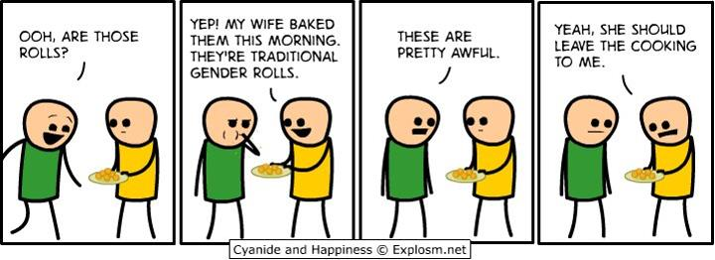

Slide 8
Schemas (bartlett)
Schemas are mental molds into which
we pour our experiences.

Slide 9
Schema Theory
In psych, many theories/studies support this
Most theorize our human schemas develop very early in life, infant cognition begins immediately
Often measured and understood through studying language and grounded in the cultural components language transmits
We’re starting with schema & memory though and will revisit language soon

Slide 10
The Phenomenon of Memory
Definition -
Memory is any indication that learning has persisted over time. It is our ability to store and retrieve information.
Notes:
OBJECTIVE 1| Define memory, and explain how flashbulb memories differ from other memories.

Slide 11
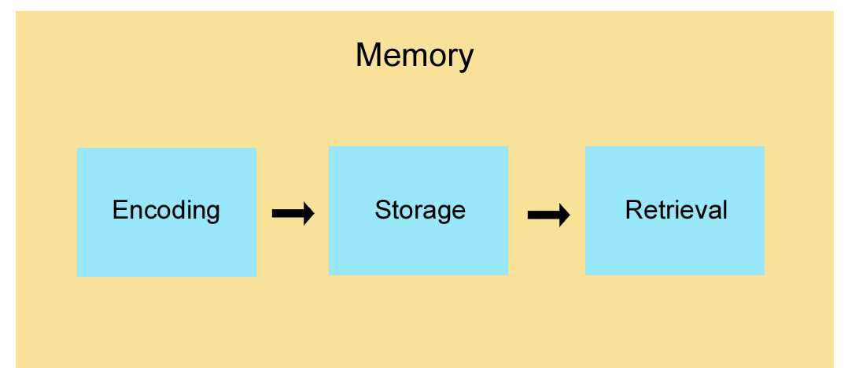
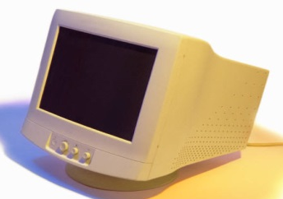
Stages of Memory
Keyboard
(Encoding)
Disk
(Storage)
Monitor
(Retrieval)
Sequential Process

Slide 12
Information Processing
The Atkinson-Schiffrin (1968) three-stage model of memory (aka multi-store model) includes
a) sensory memory, b) short-term memory, and
c) long-term memory.
But it’s now considered an outdated model, most significant for the subsequent research it spawned
Notes:
OBJECTIVE 2| Describe Atkinson-Schiffrin’s classic three-stage model of memory and explain how contemporary model of working memory differs.

Slide 13
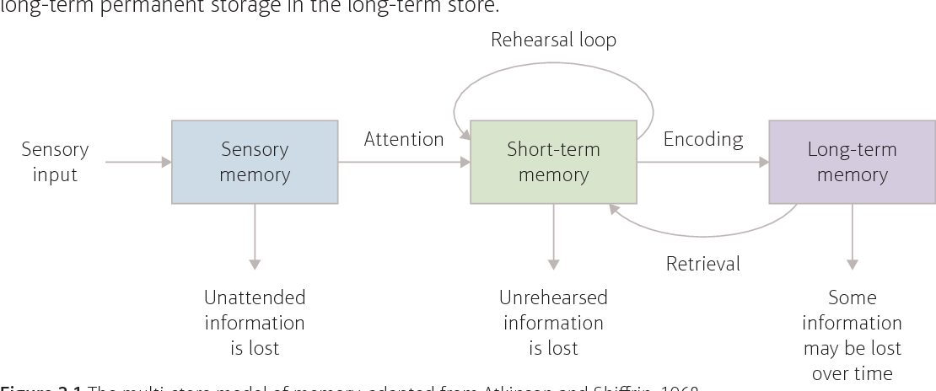
Multi-Store Memory (MSM) Model

Slide 14
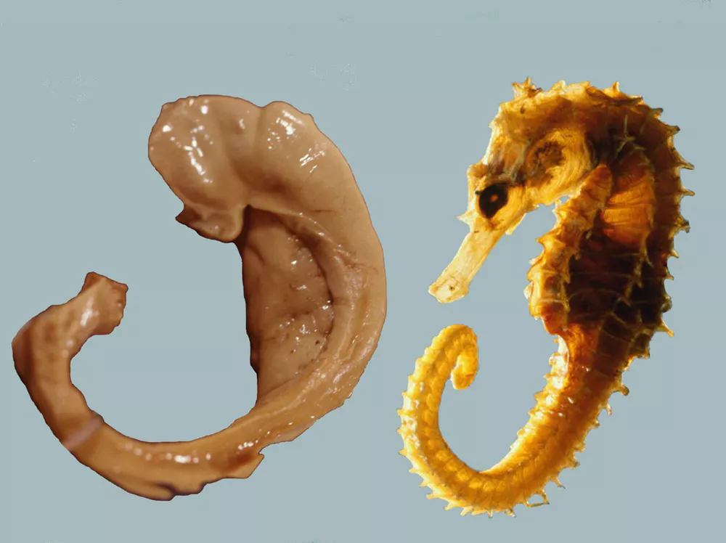
Brain Part - Hippocampus

Slide 15
An example of a Strength
I’m going to show you a list of words.
When you see the recall slide, write down as many as you can, order is not important.

Slide 17
bed

Slide 18
night

Slide 19
rest

Slide 20
awake

Slide 21
toss

Slide 22
tired

Slide 23
dream

Slide 24
wake

Slide 25
night

Slide 26
snooze

Slide 27
blanket

Slide 28
doze

Slide 29
artichoke

Slide 30
slumber

Slide 31
snore

Slide 32
turn

Slide 33
nap

Slide 34
peace

Slide 35
yawn

Slide 36
drowsy

Slide 37
night

Slide 39
Recall

Slide 41
We are more likely to remember things at the beginning or end of a series – how many of you remembered bed, rest, awake or peace, yawn, drowsy?
Glanzer & Cunitz (Primacy-Recency) Serial Position Effect
Unusual or remarkable things though stand out – how many had “artichoke”?
Repetition leads to higher recall as well - how many remembered “night”?
Chunking – who remembered “toss” & “turn”?
Déjà vu – how many of you remembered sleep?
One more exercise – get in a circle
This is called the next-in-line effect

Slide 42
Answers
bed
night
rest
awake
toss
tired
dream
wake
night
snooze
blanket
doze
artichoke
slumber
snore
turn
nap
peace
yawn
drowsy
night

Slide 43
Problems with THAT Model
Some information skips the first two stages and enters long-term memory automatically.
- Space - Time - Frequency - Images
Let’s do an example with images
Since we cannot focus all the sensory information in the environment, we select information (through attention) that is important to us.
- Nose
- Tongue
- Pants
The nature of short-term memory is more complex.

Slide 44
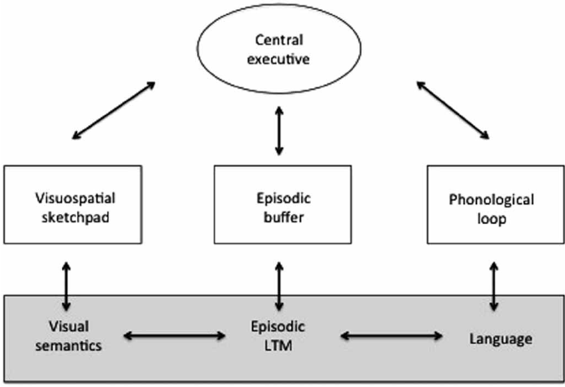
Working Memory
Alan Baddeley (2002) proposes that working memory contains auditory and visual processing controlled by the central executive through an episodic buffer.

Slide 45
Examples
Moonwalking with Einstein
Michael Cole

Slide 46
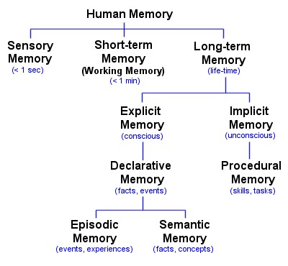

Slide 47
Limitations with Working Memory Model
No clear indication of where or how any of this stuff works
Hippocampus and synapses are involved as is the cortex, amygdala, both hemispheres etc.

Slide 48
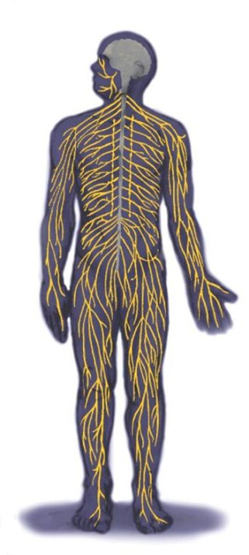
The Nerves
Nerves consist of neural “cables” containing many axons. They are part of the peripheral nervous system and connect muscles, glands, and sense organs to the central nervous system.

Slide 49
Neural Communication
The body’s information system is built from billions of interconnected cells called neurons.
Estimated that there are b/w 10-100 billion that can make 13 trillion connections

Slide 50
Neuron
A nerve cell, or a neuron, consists of many different parts.
Notes:
OBJECTIVE 3| Describe parts of a neuron and explain how its impulses are generated.

Slide 51
Neurotransmission & Action Potentials
Neurotransmission is the process by which messages are sent between neurons
When an individual neuron “fires” it is called an action potential – it’s an all or nothing response – it either fires or doesn’t

Slide 52
Refractory Period
Refractory Period: After a neuron fires an action potential it pauses for a short period to recharge itself to fire again.

Slide 54
Synapse
A junction between the axon tip of the sending neuron and the dendrite or cell body of the receiving neuron. This tiny gap is called the synaptic gap or cleft.
Notes:
OBJECTIVE 4| Describe how nerve cells communicate. Synapse was coined by Lord Sherrington (1857-1952) who inferred it through behavioral experiments. Cajal (1852-1934) described the synapse based on his anatomical studies of the brain.

Slide 55
Neurotransmitters
Neurotransmitters (chemicals) released from the sending neuron travel across the synapse and bind to receptor sites on the receiving neuron, thereby influencing it to generate an action potential.

Slide 56
Lock & Key Mechanism
Neurotransmitters bind to the receptors of the receiving neuron in a key-lock mechanism.
Notes:
OBJECTIVE 6| Explain how drugs and other chemicals affect neurotransmission, and describe the contrasting effects of agonists and antagonists.

Slide 57
Agonists

Slide 58
Antagonists

Slide 59
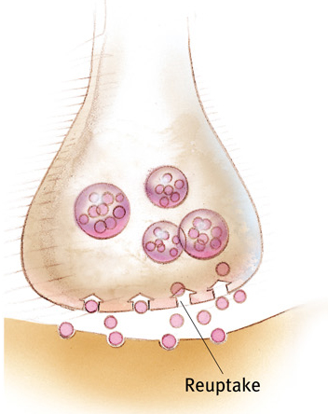
Reuptake
Neurotransmitters in the synapse are reabsorbed into the sending neurons through the process of reuptake. This process applies the brakes on neurotransmitter action.

Slide 60
Neurotransmitters
Neurotransmitter | Function(s)
Acetylcholine | Enables muscle action, learning & some memory (muscle memory - more specifically, habits)
Dopamine | Influences voluntary movement, learning, feelings of pleasure
Endorphins | Painkillers, lead to feelings of euphoria
Norepinephrine | Alertness & arousal – stimulates sympathetic nervous system
Serotonin | Affects mood, hunger, sleep, and arousal (primary drives) – limbic system

Slide 61
Martinez & Kesner, 1991
Acetylcholine and Memory in rats
Aim: to determine how blocking the acetylcholine receptors or reuptake in the brain affects spatial memory
Procedure: Rats learned to navigate a maze
Block ACh in 1 group of rats with scopolamine, prevent its reuptake in group 2 with physostigmine, and control group 3
Results: Group 1 slowest at going through maze; Group 2 faster than both other groups and fewer mistakes

Slide 62
Antonova et al (2010)
Acetylcholine and Memory in humans
Aim: to determine how blocking the acetylcholine receptors in the brain affects spatial memory
Procedure: 20 male students were injected with either scopolamine or a placebo and then placed in an fMRI scan while playing the "Arena task." Once the students found the pole, the screen went black, and the game started over.
Results: The scopolamine group took longer and made more mistakes the second time and had significant reduction in hippocampus use. Acetylcholine plays a key role in the encoding of spatial memories.

Slide 63
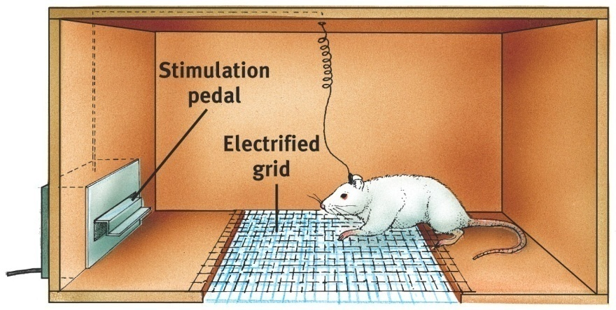
Localization of Brain Function & the Reward Center
James Olds (1950’s) Rats cross an electrified grid for self-stimulation when electrodes are placed in the “reward center” called the Nucleus Accumbens
- Robert Heath (1950’s) – similar research on humans (no shock grid) , patients push button themselves – B-19 did it 1500 times in 3 hours to the point of euphoria. Disconnected despite his protests.
Pg. 44 Companion
Sanjiv Talwar, SUNY Downstate

Slide 64
Remember
It is reductionist to suggest that complex behavior is a product of the right mix of chemicals in our brains
Neurotransmission plays a role but cannot explain behavior alone
Read Purple Book 46-48 Effects of Nt on Behavior

Slide 65
Memory is Malleable
Think about our sleep serial position effect, we fill it in with schema
Bartlett – reproductive vs. Reconstructive
Thanks for the Memories reading too
Let’s try another example
Watch the following video – Brain Games

Slide 66
Eyewitness Questions
How many people were involved in the confrontation?
What color was the woman’s jacket?
What color was the thief’s hoodie?
What did the thief take from the old man?
Did you see the thief drop anything?
What was the victim saying?
Do you think you could pick the perpetrator(s) out of a lineup?
Describe the perpetrator(s) as much as you can

Slide 67
Eyewitness Memroy
Eyewitness identification evidence is the leading cause of wrongful conviction in the United States.

Slide 68
Eyewitness memory
Of the more than 200 people exonerated by way of DNA evidence in the US, over 75% were wrongfully convicted on the basis of erroneous eyewitness identification evidence.

Slide 69
The Innocence Project
Facilitated the exoneration of 351 people who were convicted of crimes they did not commit, as a result of faulty eyewitness evidence (as of 2017).
A number of these cases have received attention from the media.

Slide 70
Loftus!

