Slide 1
Gender & Human Sexuality

Slide 2
Briefly Write
What does it mean to be male? What does it mean to be female?
What does it mean to be a woman? What does it mean to be a man?
Are there quantifiable difs. b/w men and women?

Slide 3
Questions
Which gender talks more? Which is more likely to touch the person they’re talking to? Are women better communicators?
Men, Men, No – they just communicate dif. than XX’s
What characteristics (rank 5-6) do XX’s look for in a mate?
Socioecon, Ambition, Character, Intelligence, Personality/Humor, Phys. Attractiveness
What characteristics (rank 5-6) do XY’s look for in a mate?
Phys. Attraction, Character, Intelligence, Personality/Humor, Socioecon

Slide 4
Gender
The biologically and socially influenced characteristics by which people define male and female
What are biological influences on gender?
What are social influences on gender?

Slide 5
Gender Development
- Based on genetic makeup, males and females are alike, since the majority of our inherited genes (45 chromosomes are unisex) are similar.
- Males and females differ biologically in body fat (XX’s 70% more), muscle (XY’s 40% more), height (XY’s 5 in. more), onset of puberty (XX’s 2 yrs. earlier), and life expectancy (XX’s 5 yrs. more).
Notes:
OBJECTIVE 25| List one way males and females are similar, and other ways they differ.

Slide 6
Biology of Sex – The Nature of Gender
Biological sex is determined by the twenty-third pair of chromosomes. If the pair is XX, a female is produced. If the pair is XY, a male child is produced.
Notes:
OBJECTIVE 29| Explain how biological sex is determined, and describe the role of sex hormones in biological development and gender differences.

Slide 7
Theory of Psychosexual Differentiation
- Inherently, we are predisposed to act & feel male or female. In the mother’s womb, the male fetus is exposed to testosterone (because of the Y chromosome), which leads to the development of male genitalia.
- If low levels of testosterone are released in the uterus, the result is a female.
Affects brains as well
Most evidence comes from animal studies
See Gender Dev. Examples based on Bio pg. 130

Slide 8
Biosocial Theory of Gender Development
(Money & Ehrhardt, 1972) Interaction b/w bio and social factors
Hormones and labels affect how kids get socialized
Dev. of gender identity & adherence to gender roles is a consequence of socialization
Accordingly, kids are gender neutral at birth
Basis of theory was research on intersex kids (born with both parts) – surgery, socialization equals acceptance and happiness
Or does it?

Slide 9
Gender Roles: Theories
Gender Schema Theory suggests that we learn a cultural “recipe” of how to be a male or a female, which influences our gender- based perceptions and behaviors (Martin & Halvorson, 1978).
Key is labeling oneself as boy or girl – one then can form a gendered schema
They try to be like others in their group
Observe same-sex models
Also form schemas of opposite sex

Slide 10
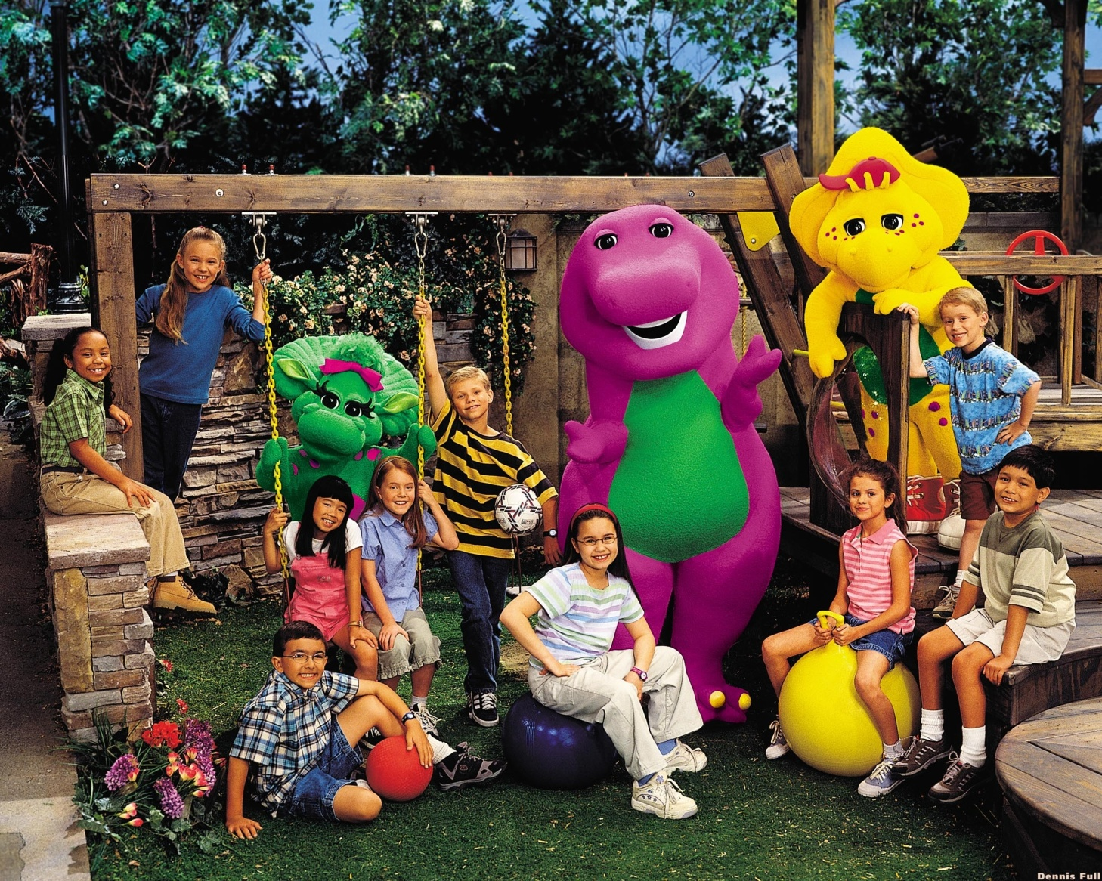
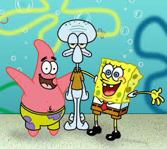
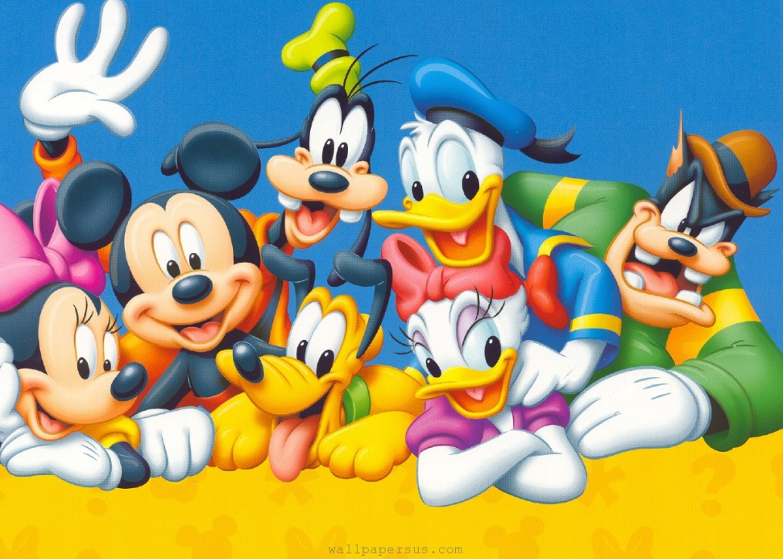
Impact of Gender Schemas
Impacts what they pay attention to, learn, remember and choose to do
For example, why so many kids shows/books marketed to both boys and girls but with male rather than female leads/title characters/protagonists?

Slide 11
Impact of Gender Schemas
Schemas serve as internal, self-regulating standards
Schemas can lead to self-fulfilling prophecies
or stereotype threat
Can distort perception and warp memory – M&H in 1984 showed pics to kids that aligned with gender schema and those that didn’t (girl with gun, boy with doll). A week later kids misremembered non-schema supporting memories as fitting the schema (girl with doll)

Slide 12
Strengths & Limitations of Gender Schema Theory
Explains how notions of gender continue throughout development
It depicts kids as actively trying to make sense of the world
Personally, I like it cuz it dovetails nicely with SCT
Limitation – focuses a lot on the individual kid-social and cultural factors not addressed
Hard to explain how/why schemas dev. and take the form they do

Slide 13
Gender Roles
Our culture shapes our gender roles — expectations of how men and women are supposed to behave.
Gender Identity — means how a person views himself or herself in terms of gender.
Gender Constancy – you remain male or female despite changing clothes, appearance etc. (video clip)
Notes:
OBJECTIVE 29| Discuss the relative importance of heredity and environment on gender development, and describe two theories of gender-typing.

Slide 14
2. Social Role Theory
Eagly (1987) gender roles (and therefore stereotypes) come from the different roles men and women play in a society/culture
Roles they get are what best suit them
Cross culturally, even kids stereotype early
Roles probably based on childbearing and nursing
Not etic though – Mead’s New Guinea studies and modern day observations of changing roles

Slide 15
Culture & Gender
Differing sex roles is a cultural etic
Nature of those differences is emic
Wood & Eagly (2002) – surveyed 185 societies
See next slide table 6.2 pg. 165 in Culture & Psych Book
Wood & Eagly argued that “physical differences between the sexes interacted with the resources and characteristics of the environment so that different societies produced different solutions to the needs of survival”
Called this model Biosocial Model of sex differences

Slide 17
Gender and Social Power/Interaction
In most societies, men are socially dominant and are perceived as such.
In 2005, men accounted for 84% of the governing parliaments.
XX’s more supportive, XY’s more opinionated
XY’s initiate more assertive, touchy, interruptive
XX’s more empathetic
Notes:
OBJECTIVE 27| Describe some gender differences in social power.

Slide 18
Gender Differences in Aggression
- Men express themselves and behave in more aggressive ways than do women. This aggression gender gap appears in many cultures and at various ages.
- In males, the nature of this aggression is physical.
My $64,000 question – who is more “aggressive”
the male who punches out a rival who insults him or the female who spreads lies and rumors behind her rival’s back?
Notes:
OBJECTIVE 26| Summarize gender gap in aggression.

Slide 19
Gender Differences and Connectedness
Young and old, women form more connections (friendships) with people than do men. Men emphasize freedom and self-reliance.
Oliver Eltinger/ Zefa/ Corbis
Dex Image/ Getty Images
Notes:
OBJECTIVE 28| Discuss gender differences in connectedness, or the ability to “tend and befriend.”

Slide 20
Gender Stereotypes
Williams & Best (1982) surveyed 3,000 university students from 30 countries: 52-120 per country
Adjective Check List (ACL) – male or female?
More than 2/3 of country residents consensus on the adjective - that’s robust
More than 2/3 of the countries consensus – that’s etic
Results were so striking that it suggests there are universal gender stereotypes that transcend culture

Slide 22
William & Best (1982) – Second Analysis
2nd analysis of results looked at favorability, strength and activity to see how the adj. were distributed according to affective and emotional meaning
Those for men were stronger/more active than women in all countries
Favorability had differences: Japan & S. Africa e.g. rated the male characteristics more favorable whereas Italy & Peru e.g. rated female more favorable

Slide 23
Evaluation
Division of labor based on reproductive differences = psychological differences?
Evolutionary/adaptive advantages?
Est. mindsets based on perceived social inequities, social forces, media influence etc.?
Too much homogeneity among college students?
Williams & Best did a follow up study with children in 1990 and found considerable agreement between the college kids and the children

Slide 24
Evaluation cont’d
Williams, Satterwhite & Best did a follow up study in 1999, by rescoring 25 countries’ data on the “Big 5” or Five Factor Model of Personality (etic traits) (description = a high score):
Openness to Experience: intellectually curious, open to emotion, interested in art, and willing to try new things
Conscientiousness: preference for planned rather than spontaneous behavior
Extroversion: pronounced engagement with the external world
Agreeableness: value getting along with others are generally considerate, kind, generous, trusting and trustworthy, helpful, and willing to compromise their interests with others and have an optimistic view of human nature
Neuroticism: emotionally reactive and vulnerable to stress
Males higher on all but agreeableness
Culturally – gender stereotype differentiation was higher in conservative, hierarchical, less Christian and lower socio-econ societies and with lowered proportion of women in college
Countries that value harmony, egalitarianism and less tradition sex-roles viewed male stereotypes less favorably and less differentiation on the 5 Factors

Slide 25
Gender Roles
Williams & Best (1990) – 14 countries complete the ACL in relation to what they believe they are and what they want to be
Gender difs. w/in cultures were small but varied greatly cross culturally
Women & countries like Netherlands, Germany & Finland were more egalitarian whereas Men and countries like Nigeria, Pakistan and India were more traditional
Also, high socio-econ, high Protestants, low Muslims, high women employed outside the home, high women in college, and higher individualism correlate with egalitarianism

Slide 26
Gender Roles – Judith Gibbons
Lots of good studies on gender roles, adolescent views of gender roles, etc. pg. 171 in Culture & Psych Book
Homework read 173-177 in Culture & Psych Book

Slide 27
Human Sexuality
Gender Differences in Sexuality
Males and females, to a large extent, behave and think similarly. Differences in sexes arise in regards to reproductive behaviors.
Question (summarized) | Male | Female
Casual sex | 60% | 35%
Sex for affection | 25% | 48%
Think about sex everyday | 54% | 19%
Notes:
OBJECTIVE 12| Identify gender differences in sexuality.

Slide 28
Reflections on Nature and Nurture
Notes:
OBJECTIVE 30| Describe the biopsychosocial perspective on development.

