Slide 1
Descriptive and Inferential Statistics
Or How I Learned to Stop Worrying and Love My IA

Slide 2
Data Types
Called Levels of Measurement
Nominal
Ordinal
Interval
Ratio

Slide 3
Nominal
Not normally distributed
Collected in mutually exclusive categories
Categories cannot be ranked & don’t overlap
Yes or No type answers
This Photo by Unknown Author is licensed under CC BY-SA

Slide 4
Ordinal
Most experiments are Ordinal
Not normally distributed
Ranked data that may overlap and are not mutually exclusive
Most human characteristics are ordinal guilty - innocent, happy - sad etc.
No inherent meaning to numbers assigned here
Works well with small subject size
This Photo by Unknown Author is licensed under CC BY

Slide 5
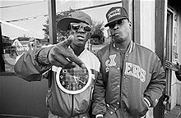
Interval
Normal distribution
Rank data and exact difference between the rankings are known
For ex. time to complete tasks
Human characteristics must be converted to a number that falls into percentile ranks on a normal curve
When in doubt treat data as ordinal e.g. words recalled – are some easier to recall, differences b/w men and women?
This Photo by Unknown Author is licensed under CC BY-SA

Slide 6
Ratio
Normal distribution
True zero point meaning an absence of something
Data can be measured as a ratio to other data i.e. one can be twice as high as another
Informally it can be a how much or how many measurement
More often used in natural sciences
This Photo by Unknown Author is licensed under CC BY

Slide 7
General Info
Everyone should select one measure of central tendency and one measure of dispersion
Mean, median and mode are all averages – so avoid using the word “average”
Justification of level of measurement, descriptive stats & inferential stats – use the design!
Need to use a completely labeled graph for descriptive stats only
Written summary of graphed data
Raw data and calculations go in Appendices

Slide 8
Descriptive Stats
Mean is the sum of all scores in the data set divided by the number of scores
Downside: Outliers can really skew it
Median is the midpoint score of the data set
Not affected by extremes, and helps with skewed data
Mode is the most frequently occurring score
Mostly categorical usage

Slide 9
Measures of Dispersion
The degree to which scores differ from one another
Nominal data cannot have dispersion as it collects data by category
Range – distance between lowest and highest
Easily effected by outliers
Inter (and semi-inter) quartile range – range of the middle 50% of scores (or half of that)
Less effected by extremes

Slide 10
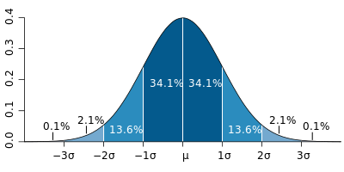
Measures of Dispersion
Standard Deviation – best for a normal distribution, is the average deviation between the mean and the observed score (square root of the variance: how dispersed scores are from the mean)
Mean and Standard Deviation require a normal distribution, means

Slide 11
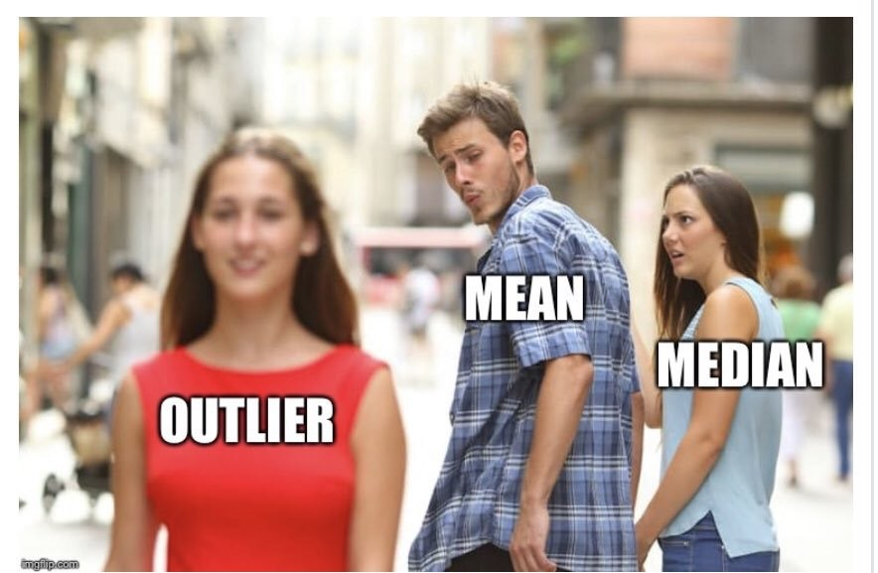
In summary…

Slide 12
Inferential Stats
Is there a significant difference between the groups/conditions?
Just because there is a noticeable difference in means/medians doesn’t mean it’s significant
Gets you a Level of Significance (p)
Level of Significance is the probability that it was the independent variable, not chance that caused the change in the dependent variable
Social science allows a max of 5% error or p < .05
Used to reject (or fail to reject) the null hypothesis

Slide 13
Descriptive Stats
Level of Measurement | Measure of Central Tendency | Measure of Dispersion
Nominal | Mode | N/A
Ordinal | Median | Interquartile range & semi-interquartile range
Interval | Mean | Variance & standard deviation
Ratio | Mean | Variance & standard deviation

Slide 14
Inferential Stats
Level of Measurement | Independent Samples | Repeated Measures
Nominal | Chi Square | N/A
Ordinal | Mann-Whitney U Best for small subject groups and no normal distribution | Wilcoxon
Interval/Ratio | t test for independent groups (unrelated t test) If you use a t test you must do more to justify its use (see next slide) | t test for dependent groups (related t test)

Slide 15
3 Requirements to use a t Test
If any of these 3 conditions are not present – move to an ordinal level test
Interval/Ratio is the correct level of measurement
Data is normally distributed (no extremes)
In independent sample designs only, are the experimental and control groups homogenous in variance i.e. the same size
- More than 4:1 if a group is < 10.

