Slide 1
Culture

Slide 2
Why culture?
Moghaddam (1993) Humans have an ‘interactive’ relationship with culture – we shape culture and we are also shaped by it
Jahoda (1978) believes that ‘Cultural Evolution’ rather than ‘Biological Evolution’ the reason for our progress and civilization today

Slide 3
A definition of culture….
Culture is defined by Matsumoto (2004) as “a dynamic system of rules, explicit and implicit, established by groups in order to ensure their survival, involving attitudes, values, beliefs, norms, and behaviors”.
This is a complex definition, so we will look at it piece by piece.
Culture is dynamic—it changes over time in response to environmental and social changes. It also exists on many levels.

Slide 4
What are cultural norms?
Cultural norms are behavior patterns that are typical of specific groups. They are often passed down from generation to generation by observational learning by the group’s gatekeepers—parents, teachers, religious leaders, and peers.
Cultural norms include such things as how marriage partners are chosen, attitudes towards alcohol consumption, and acceptance (or rejection) of spanking children.

Slide 5
Cultural Norms of Behavior
When negotiating in western countries, the objective is to work towards a target of mutual understanding and agreement, and shake hands when that agreement is reached—a cultural signal of the end of negotiations and the start of working together.
In Middle Eastern countries, much negotiation takes place leading into the agreement, signified by shaking hands.
However, this does not signal that the deal is complete. In fact, in Middle Eastern culture it is a sign that serious negotiations are just beginning.
These things though are somewhat arbitrary – Hank Green?

Slide 6
IB syllabus says:
Examine the role of two cultural dimensions on behavior (Individualism vs. Collectivism, Time Orientation, Power Distance)
Understanding and respect
for cultural norms can promote
successful interactions

Slide 7
The dimensions of culture are etics: A valid way to make cross-cultural comparisons
Triandis, Hofstede, and Hall are 3 important contributors (Hank Davis, 2008).
A dimension of culture is “an aspect of culture that can be measured relative to other cultures” (Hofstede & Hofstede, 2005).
The dimensions are continuums of behavior and are etics. We have access to both ends but have tendencies toward one or the other.
Any etic can be a dimension of culture but must be backed up with research showing that it really is universal.
Avoid oversimplification and ethnocentrism. Do not assume that a behavior observed in one culture applies universally.

Slide 8
Which dimensions to study?
Hofstede identified:
Individualism-collectivism
Masculinity-femininity
Power distance
Uncertainty avoidance
Long and short term orientation
Evaluation: He studied organizational cultures (through IBM corporation) and made generalizations about nations; it was a cross-industry study and not really a cross-cultural study (Hank Davis, 2008).

Slide 9
Other Dimensions
Time orientation
The independent and interdependent self
Context
Tightness

Slide 10
Individualism-collectivism is the most studied dimension
INDIVIDUALISM
Individual and group goals
Privacy
Identity as an individual right
Laws rights and responsibilities are equal for all
Purpose of education is learning how to learn
Economic goals are aimed at individual self-interest
Pursuit of individual happiness is the ultimate goal; sacrifice relationships
Emphasis on nuclear family
Diplomas increase ones self respect and economic well-being
Relationships are short term; contracts important in binding relationships

Slide 11
COLLECTIVISM
Group goals have priority over individual goals
Behavior regulated by group norms
Emphasis on hierarchy
Teachers have all of the answers
Self-reliance means one does not burden the group
Women and children are subordinate to men
The purpose of education is to enhance the group or country
Reliance on religion or ideological framework
Extended family
Economic goals benefit the whole

Slide 12
Triandis studied how individualism-collectivism applies to individuals: how do the dimensions affect their behavior
Triandis helps us to understand that it is a stereotype to think of an individual as strictly individualist or collectivist.
People have access to both poles and are in general, either allocentric or idiocentric, emphasizing one or the other.
Horizontal and vertical cultures
Tight and loose cultures
Research applying individualism-collectivism at the individual level to the IB learning outcomes include compliance, conformity, and self-efficacy.

Slide 13
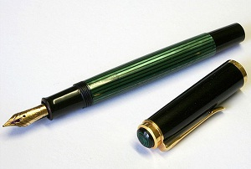
Activity 1 – Choose a Pen

Slide 14
Activity 2 – Underwater Scene

Slide 15
Questions about the Scene
How many dolphins were in the scene?
What type of fish did you see?
What color was the star fish?
What was going on above the water?
Relatively speaking, where was the light house?
How many distinct palm trees did you see?

Slide 16
Activity 3 – Line Perception
In the relative instruction condition, participants judged whether each box and line combination matched the proportional scaling of the preceding combination;
In the absolute-instruction condition, participants judged whether each line matched the previous line, regardless of the size of the accompanying box

Slide 17
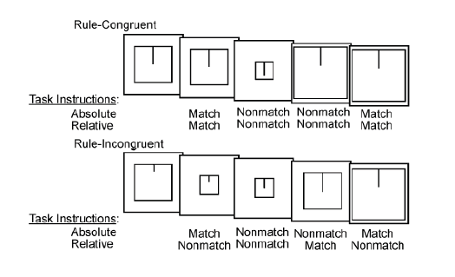
Activity 3 – Perception of a Line
Hedden, et. al., 2008

Slide 18
Edward T. Hall’s contribution to the time orientation dimension of culture
MONOCHRONIC: Do one thing at a time
Focus on time commitments; concentrate on the job at hand
Low context; need information
Think about deadlines; adhere to plans
Concern about not disturbing others; follow rules of privacy and consideration
Put the job first
Great respect for property; seldom borrow or lend things
Emphasize promptness

Slide 19
POLYCHRONIC: Do many things at once
Easily distracted
High context; already have information
Think about goals
More concern with those that are closely related than with privacy and disturbing others
Put relationships first
Borrow and lend things often and easily
Base promptness on relationship factors

Slide 20
Time Orientation affects many behaviors
Education
Stress management
Health beliefs
Mental health
Language

Slide 21
Assessing Time Orientation with the TRIOS Scale
TRIOS is a questionnaire assessing 5 interrelating qualities, time, rhythm, improvisation, orality, and spirituality (Jones, 2004, 2005).
Present time orientation unifies the TRIOS scale.
High TRIOS scores are correlated with lower grades in school and perceptions that the education system is unfair.
High TRIOS scores are also correlated with depression and rumination.

Slide 22
Assessing Time Orientation and Health Beliefs related to Hypertension Management
The Hypertension Temporal Orientation Scale asked questions such as “I treat my blood pressure now so that I can avoid future problems” (Brown & Segal, 1996).
The dependent variables were components of the Health Belief Model, such as beliefs about the severity of the problem, susceptibility to consequences of hypertension, benefits of taking medications, and barriers and costs related to medication and home remedies.
African Americans tested more present oriented than White Americans, particularly about day-to-day hypertension management.
It does little good for health care providers to give someone directions about managing chronic health problems unless the information is culturally relevant.

Slide 23
Edward Hall’s Proxemic theory (1966)
Hall’s proxemic theory (1966) is based on a culture’s need for personal space”.
In his book, The Hidden Dimension, he shows that different cultures have different perceptions of the amount of personal space that is required to be comfortable.
People only allow their closest, most intimate friends into this bubble of space.

Slide 24
Personal space….
In the US, for instance, people engaged in conversation will assume a social distance of roughly 10—15 cm/ 4—7 inches
But in many parts of Europe the expected social distance is roughly half that, with the result that Americans travelling overseas often experience the urgent need to back away from a conversation partner who seems to be getting too close.

